Slide 1
Godly Play
Scotland

Slide 2
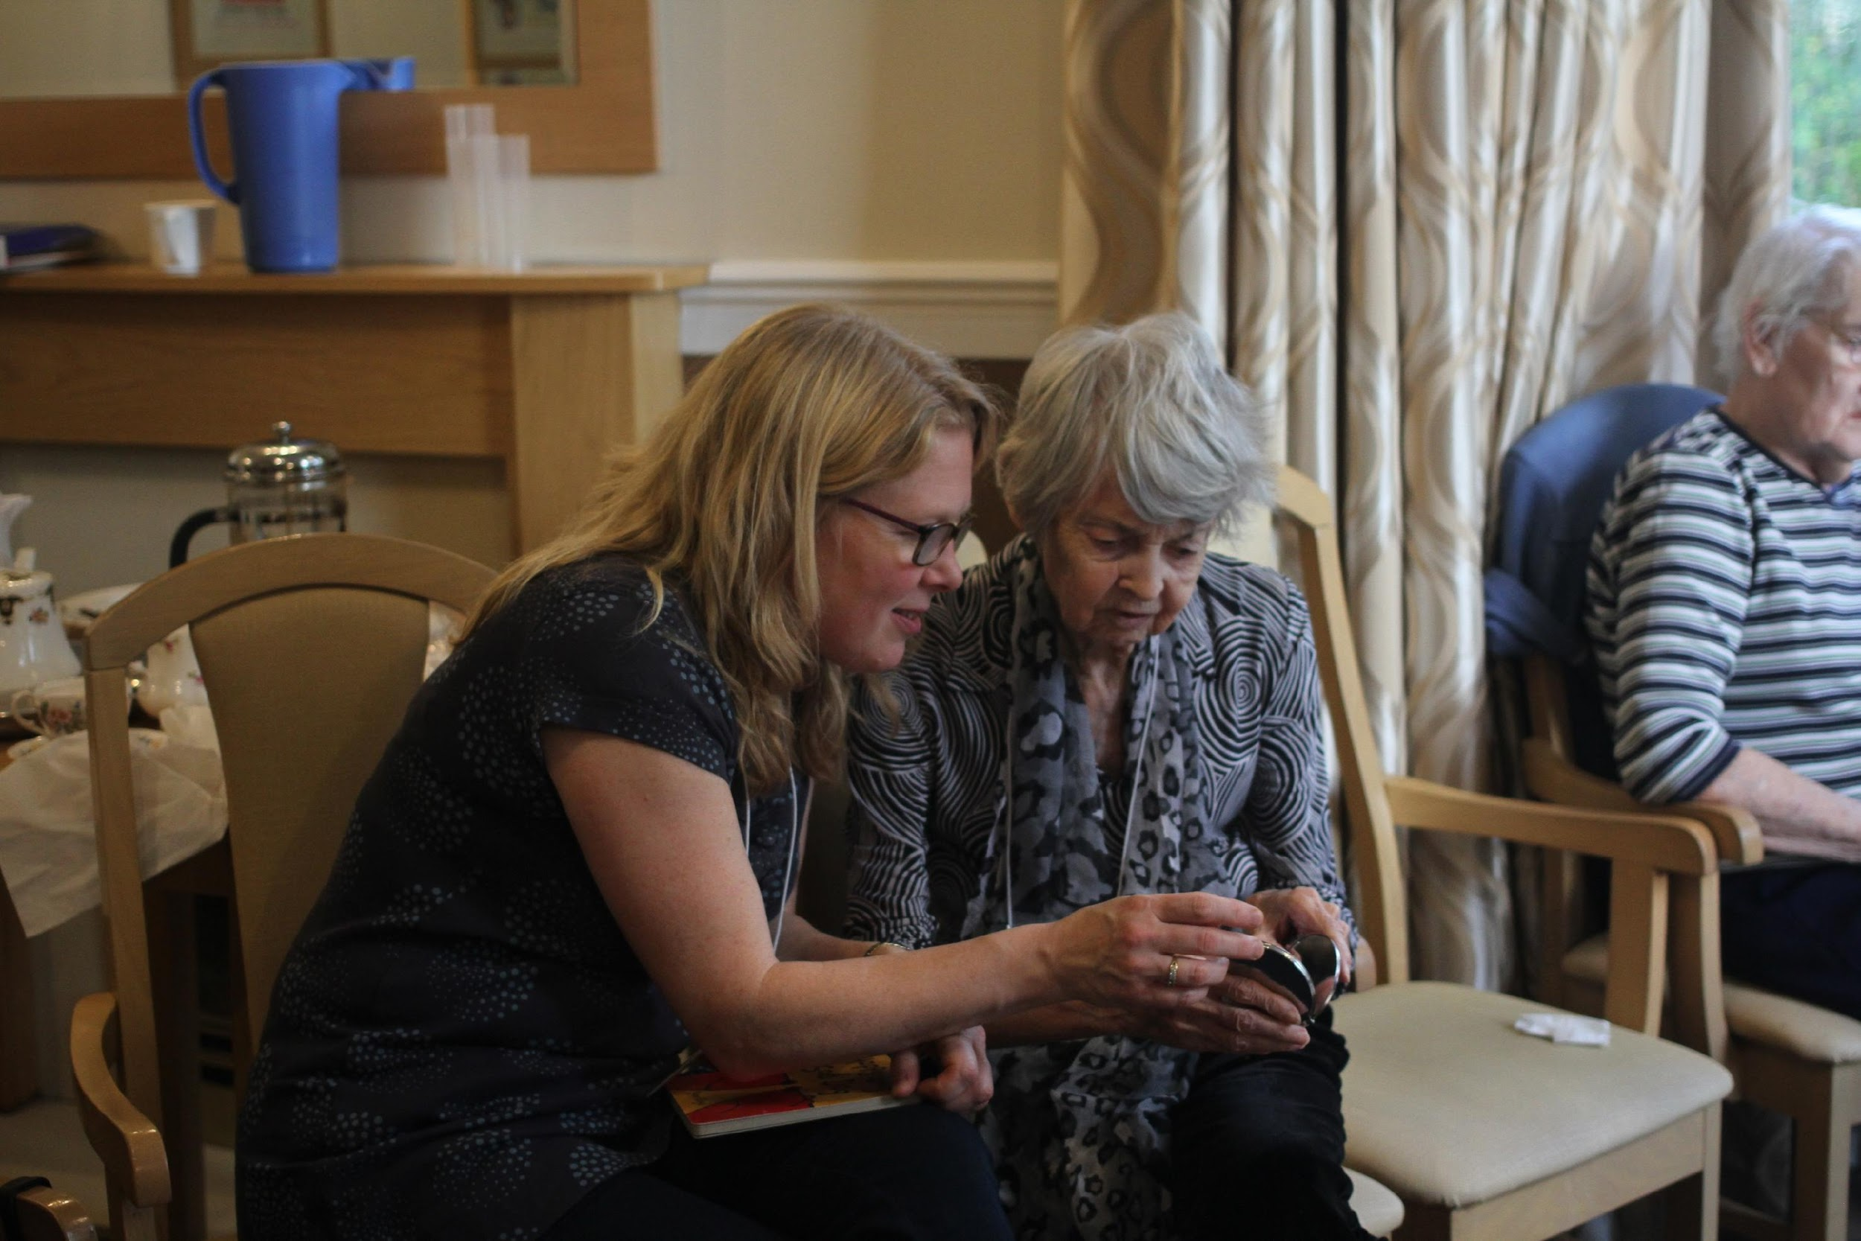
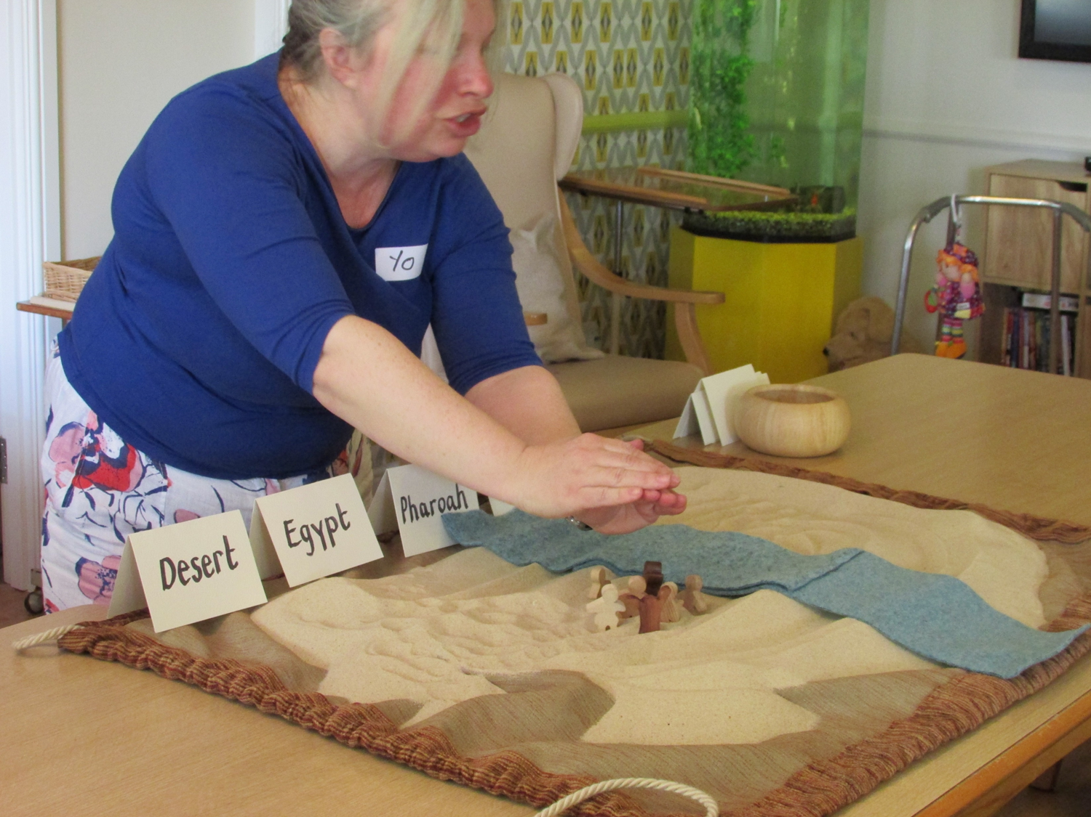
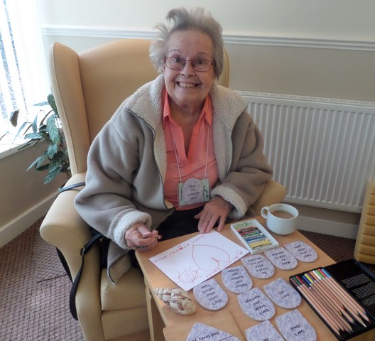
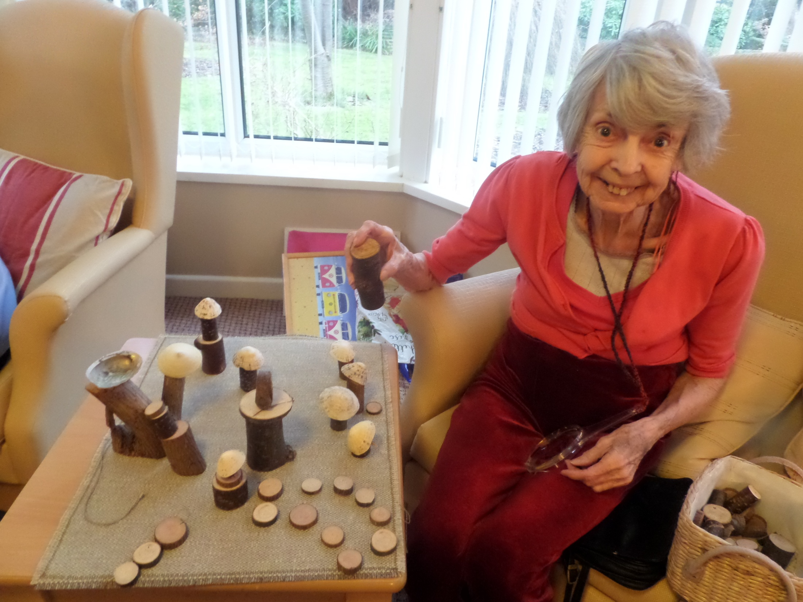
Well being through Community, Story and Creativity

Slide 3
www.godlyplayscotland.co.uk
www.storiesforthesoul.org

