Slide 1
Nurturing compassionate communities relating to death, dying, loss and care
Rebecca Patterson
Director of Good Life, Good Death, Good Grief
Caroline Gibb
Project Manager
The Truacanta Project
Notes:
Good afternoon. I’m Rebecca Patterson, and I work at the Scottish Partnership for Palliative Care. Myself and my colleague Caroline are going to explore this idea nurturing compassionate communities relating to death, dying, loss and care.

Slide 2
Coming up...
What is a ‘compassionate community’?
What does a compassionate community look like?
How do ‘compassionate communities’ come about?
Truacanta Project
Notes:
So, I thought we could explore:
What do people mean when they talk about ‘compassionate communities’ and what might a compassionate community look like
How do compassionate communities come about?
And then I’m going to hand over to my colleague Caroline, to talk about The Truacanta Project – some work we’re leading, supporting communities to take practical local action to make their own community more compassionate

Slide 3
What is a compassionate community?
Close-knit
Supportive
Kind
Neighbourly
Notes:
Often, people talk about creating a compassionate community without having a specific definition in mind, referring more loosely to the importance of communities being close-knit and supportive, of neighbourliness, and building on individual acts of kindness by ordinary people.
However, the term is also used a lot specifically in the context of improving people’s experiences of death, dying, loss and care. In this context the term 'compassionate community' refers to something more specific.

Slide 4
Compassionate Cities
“A Compassionate City is a community that recognises that care for one another at times of crisis and loss is not simply a task solely for health and social services but is everyone’s responsibility.”
Prof Allan Kellehear
Notes:
The work of Prof Allan Kellehear has been particularly influential in this area. A prominent academic, he has developed a model he called ‘compassionate cities’.
Kellehear and colleagues define a ‘compassionate city’ as a community that recognises that care for one another at times of crisis and loss is not simply a task solely for health and social services but is everyone’s responsibility.”
I don’t want to spend too much time going into a specific model or definition, but I find Kellehear’s Compassionate Cities definition helpful in illustrating the specific way in which I’m using the term ‘compassionate communities’ (which may not be how everyone understands the term).
When I use the term ‘compassionate community’ I tend to be using it to mean a community that encourages, facilitates, supports and celebrates care for one another during life's most testing moments and experiences, especially those pertaining to life-threatening and life-limiting illness, chronic disability, frail ageing and dementia, grief and bereavement, and the trials and burdens of long term care.
Compassionate communities do not assume the formal service responsibilities of health and social care services - their role is different and complimentary.

Slide 5
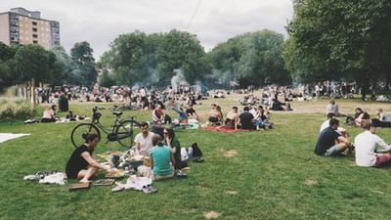
What does a compassionate community look like?
Notes:
So, we’ve briefly explored definitions, but what doe a compassionate community look like?
I’m sure everyone here has ideas about what a compassionate community should look like, but sometimes it can be hard to give exact specifics.

Slide 6
In a compassionate community, people have:
Opportunities to offer and receive support
Knowledge, skills and access to information about ill health, dying and bereavement
Environments that enable people to be supportive
Notes:
At the SPPC we’ve spent a bit of time thinking about the attributes of a compassionate community, specifically in relation to death, dying and bereavement.
It would seem that the will to be kind / compassionate isn’t enough… people have to have the right conditions that enable compassion.
We’ve found it helpful to think in terms of three distinct areas that have to be supported to enable a community to unleash its compassion: opportunities, knowledge, and environments.

Slide 7
Opportunities
People need to have opportunities to talk about, plan for, give support and receive support relating to ill health, death, dying and bereavement.

Slide 8
Knowledge, Skills and information
People need to have the knowledge, skills and information to respond to and support each other through the difficult times that can come with death, dying and bereavement.

Slide 9
Supportive Environments
Cultures/structures/networks need to be in place that enable people to give and receive support in the face of death, dying and bereavement?
Notes:
Often, people want to help each other but find that something gets in the way.
For example, many people don't know their neighbours very well, so feel that offering support could be an intrusion. Someone might want to comfort a colleague, but feel unable to leave their desk because of workplace policies. Children in school may want to offer condolences to a bereaved teacher, but be warned not to by school management.
Are there ways to break down some of these barriers? Are there ways of encouraging more supportive cultures and structures within institutions such as workplaces and schools? Can local people take action to make neighbourhoods friendlier and kinder places?

Slide 10
In a compassionate community, people have:
Opportunities to offer and receive support
Knowledge, skills and access to information about ill health, dying and bereavement
Environments that enable people to be supportive
Notes:
So, in our work to encourage more compassionate communities in Scotland, we find it helpful to base our work around these three areas – opportunities, knowledge and environments.
This way of looking at things has been supported by some work by other people too…

Slide 11
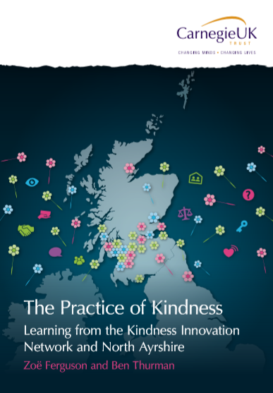
Highlights the importance of:
Organisational cultures to enable kindness
Creating informal opportunities for social interaction
Creating welcoming spaces that encourage everyday relationships and human connections
Notes:
For example some of you may be aware othat JRF and Carnegie UK did some work over the last few years exploring what kindness is and how it comes about. Their most recent report highlights the importance of
Organisational cultures to enable kindness
Creating informal opportunities for social interaction
Creating welcoming spaces that encourage everyday relationships and human connections

Slide 12
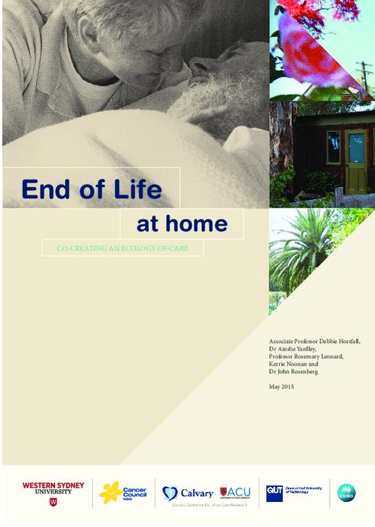
“norms of kindness”
There is a huge potential for mobilizing help from local people, and that everyday kindness is not uncommon. What is lacking is the knowledge and acceptance that it is the role of the local community to offer help.
The norms of respecting privacy seem to be much stronger than the norms of kindness”
End of Life at home Co-creating an ecology of care
Notes:
Some Australian work by Debbie Horsfall and colleagues, looked at how communities supported their members at the end of life…

Slide 13
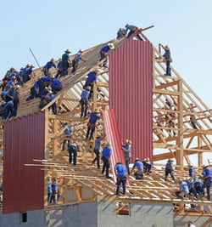
How do compassionate communities come about?
Notes:
So, how do compassionate communities come about?
I think that one of the things that the people at Carnegie were trying to do with their report was to work out how kindness comes about. I think that’s a really tricky one… if there’s an answer I’m not sure we’ve found it yet.
I mentioned the ‘compassionate cities model’ of Allan Kellehear and colleagues before. That’s quite an interesting model, setting out not just a definition but also coming with a charter that sets out what a compassionate city will look like, and attempts to describe a bit of a method to follow to achieve a Compassionate City…

Slide 14
Top down – creating the conditions
Photo by Vitaliy Paykov via Unsplash.com
Notes:
Importantly, this model highlights the need to join up top down policy support with bottom up community engagement and development.
So, you need some ‘top-down’work, engagement from people with power across different parts of a community, and manipulating the key levers of 'power' or 'politics' of civic society.

Slide 15
Top down – creating the conditions
Bottom up
Photo by Vitaliy Paykov via Unsplash.com
Notes:
However, once the structure is in place, creation of the compassionate city requires a community development (bottom-up) strategy – the community needs to not just participate, but to take ownership of the idea for it to become sustainable.
The Compassionate cities model has been extremely influential, and if you want to know more about it you can check out these references…

Slide 16
Compassionate Cities
Allan Kellehear: Compassionate Cities: Public health and End of Life Care (2005)
Karapliagkou, A. & Kellehear, A. Public Health Approaches to End of Life Care. A Toolkit.
Each community is prepared to help: Community development in end of life care – guidance on ambition six
Notes:
That model is quite theoretical, but there are people out there who’ve tried to turn the theory into practice.
There are also other models to consider, and some great examples of practical things that people have done to try to initiate more compassion in their own communities.

Slide 17
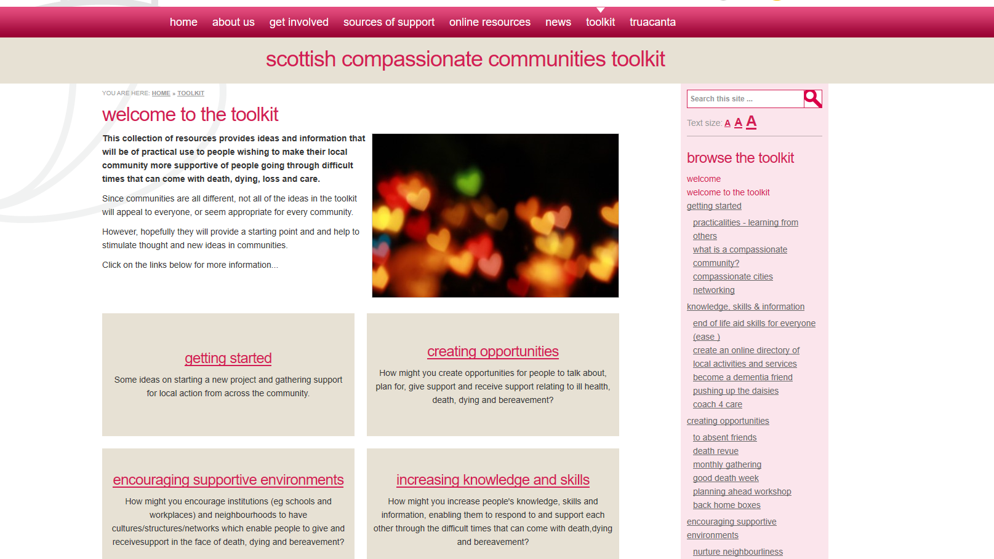
Notes:
… which is why we’ve spent some time exploring what practical ideas are out there, what people have done, and brought some of it together into an online collection of resources.
This is the website of the Scottish Compassionate Communities toolkit,The ComCom toolkit is an online collection of resources providing ideas and information aiming to of practical use to people wishing to make their local community more supportive of people going through difficult times that can come with death, dying, loss and care.
It brings together into one place practical ideas that other people ehave done, about how you can undertake local work in this area.
In the afternoon session we’re going to look in more detail at some of the examples in the toolkit.
Now I’m going to hand you over to my colleague Caroline who’s going to tell you about the Truacanta Project.

Slide 18
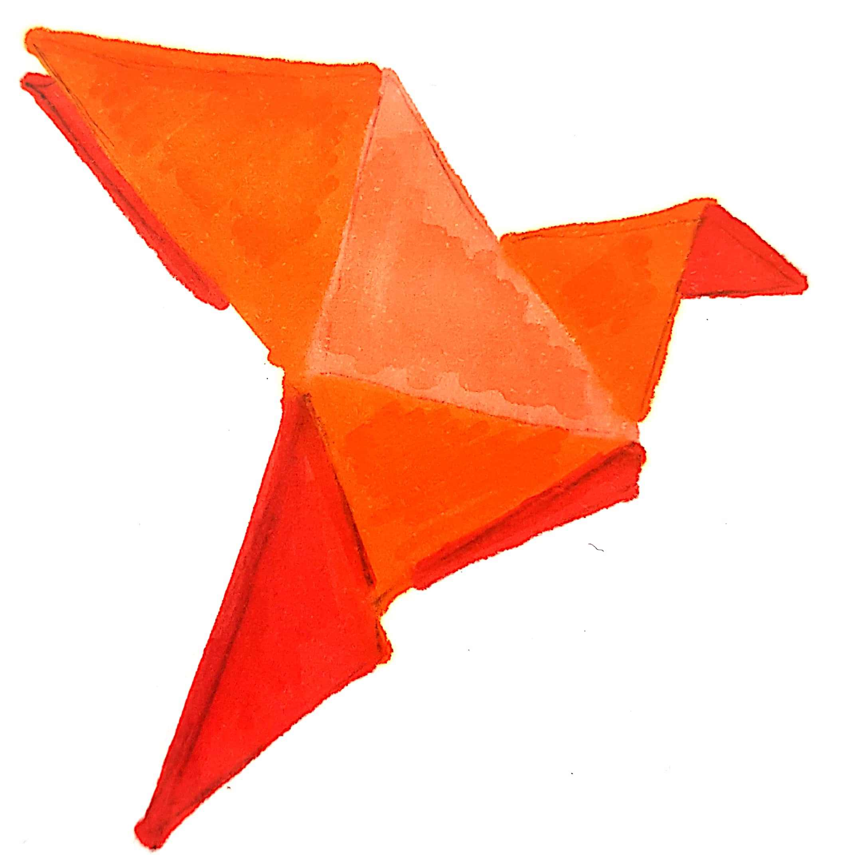
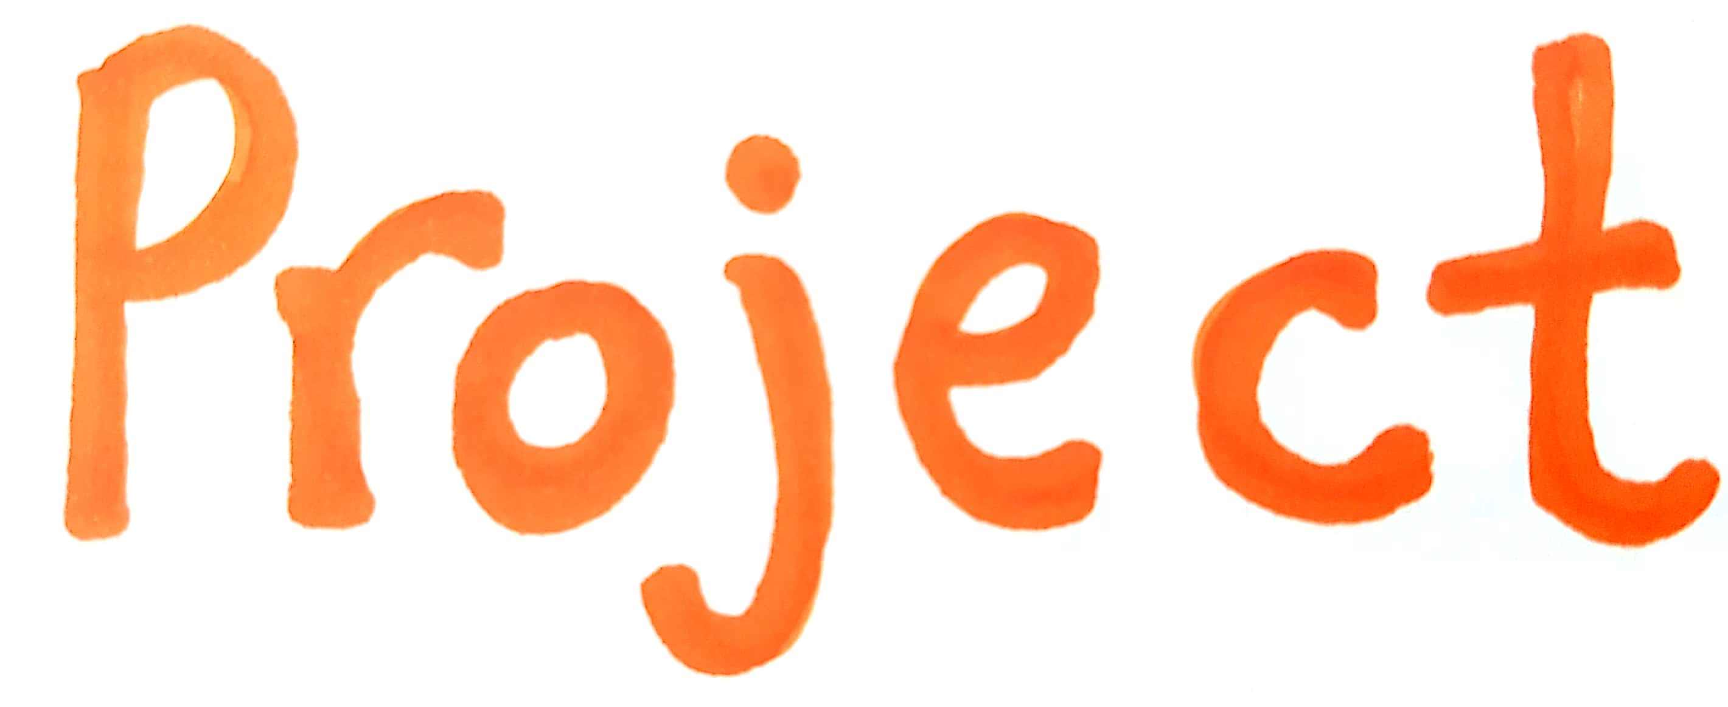
Notes:
Introduction to Truacanta

Slide 19
Notes:
Main principles of community development
Community led & owned
Rather than a group up here deciding what this group down here needs and going ahead and doing that,
the group down here decides collectively what they need, what assets & resources they have that they can uses to effect that change.

Slide 20
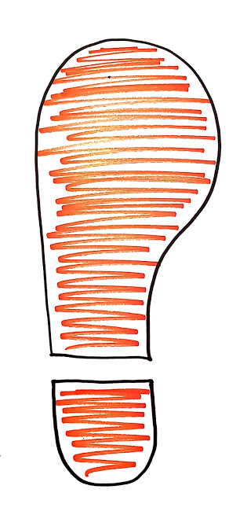
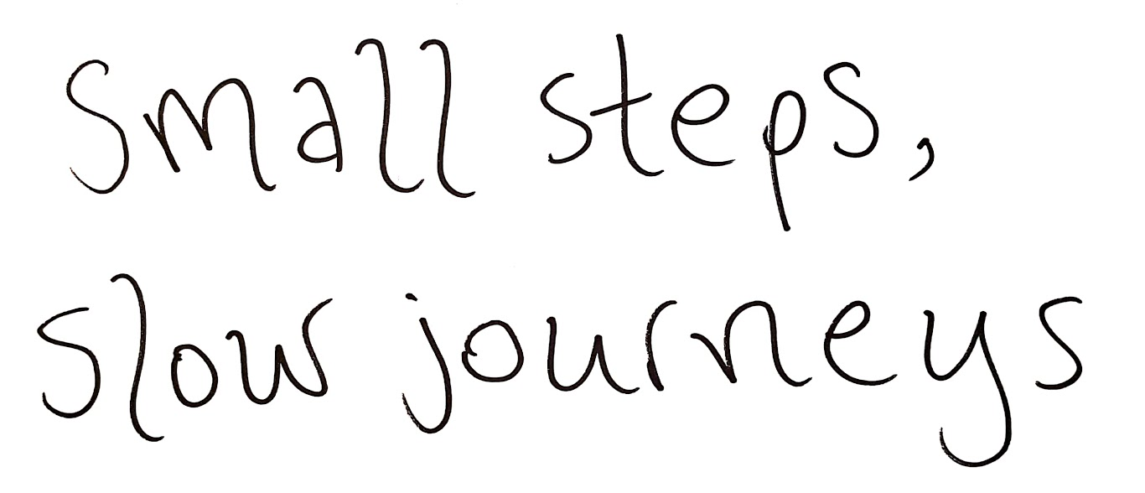
Notes:
Community = geographical
Also communities of interest, identity & practice
Community development not always so straightforward in practice
Small steps, slow journey, lots of changes of direction.

Slide 21
Notes:
A guest speaker at one of our events recently introduced this word to describe community development, which is very apt
Truacanta broad aim – helping each other with death, dying, loss and care – vague destination.
Communities moving purposefully towards that destination, learning and adapting as they go

Slide 22
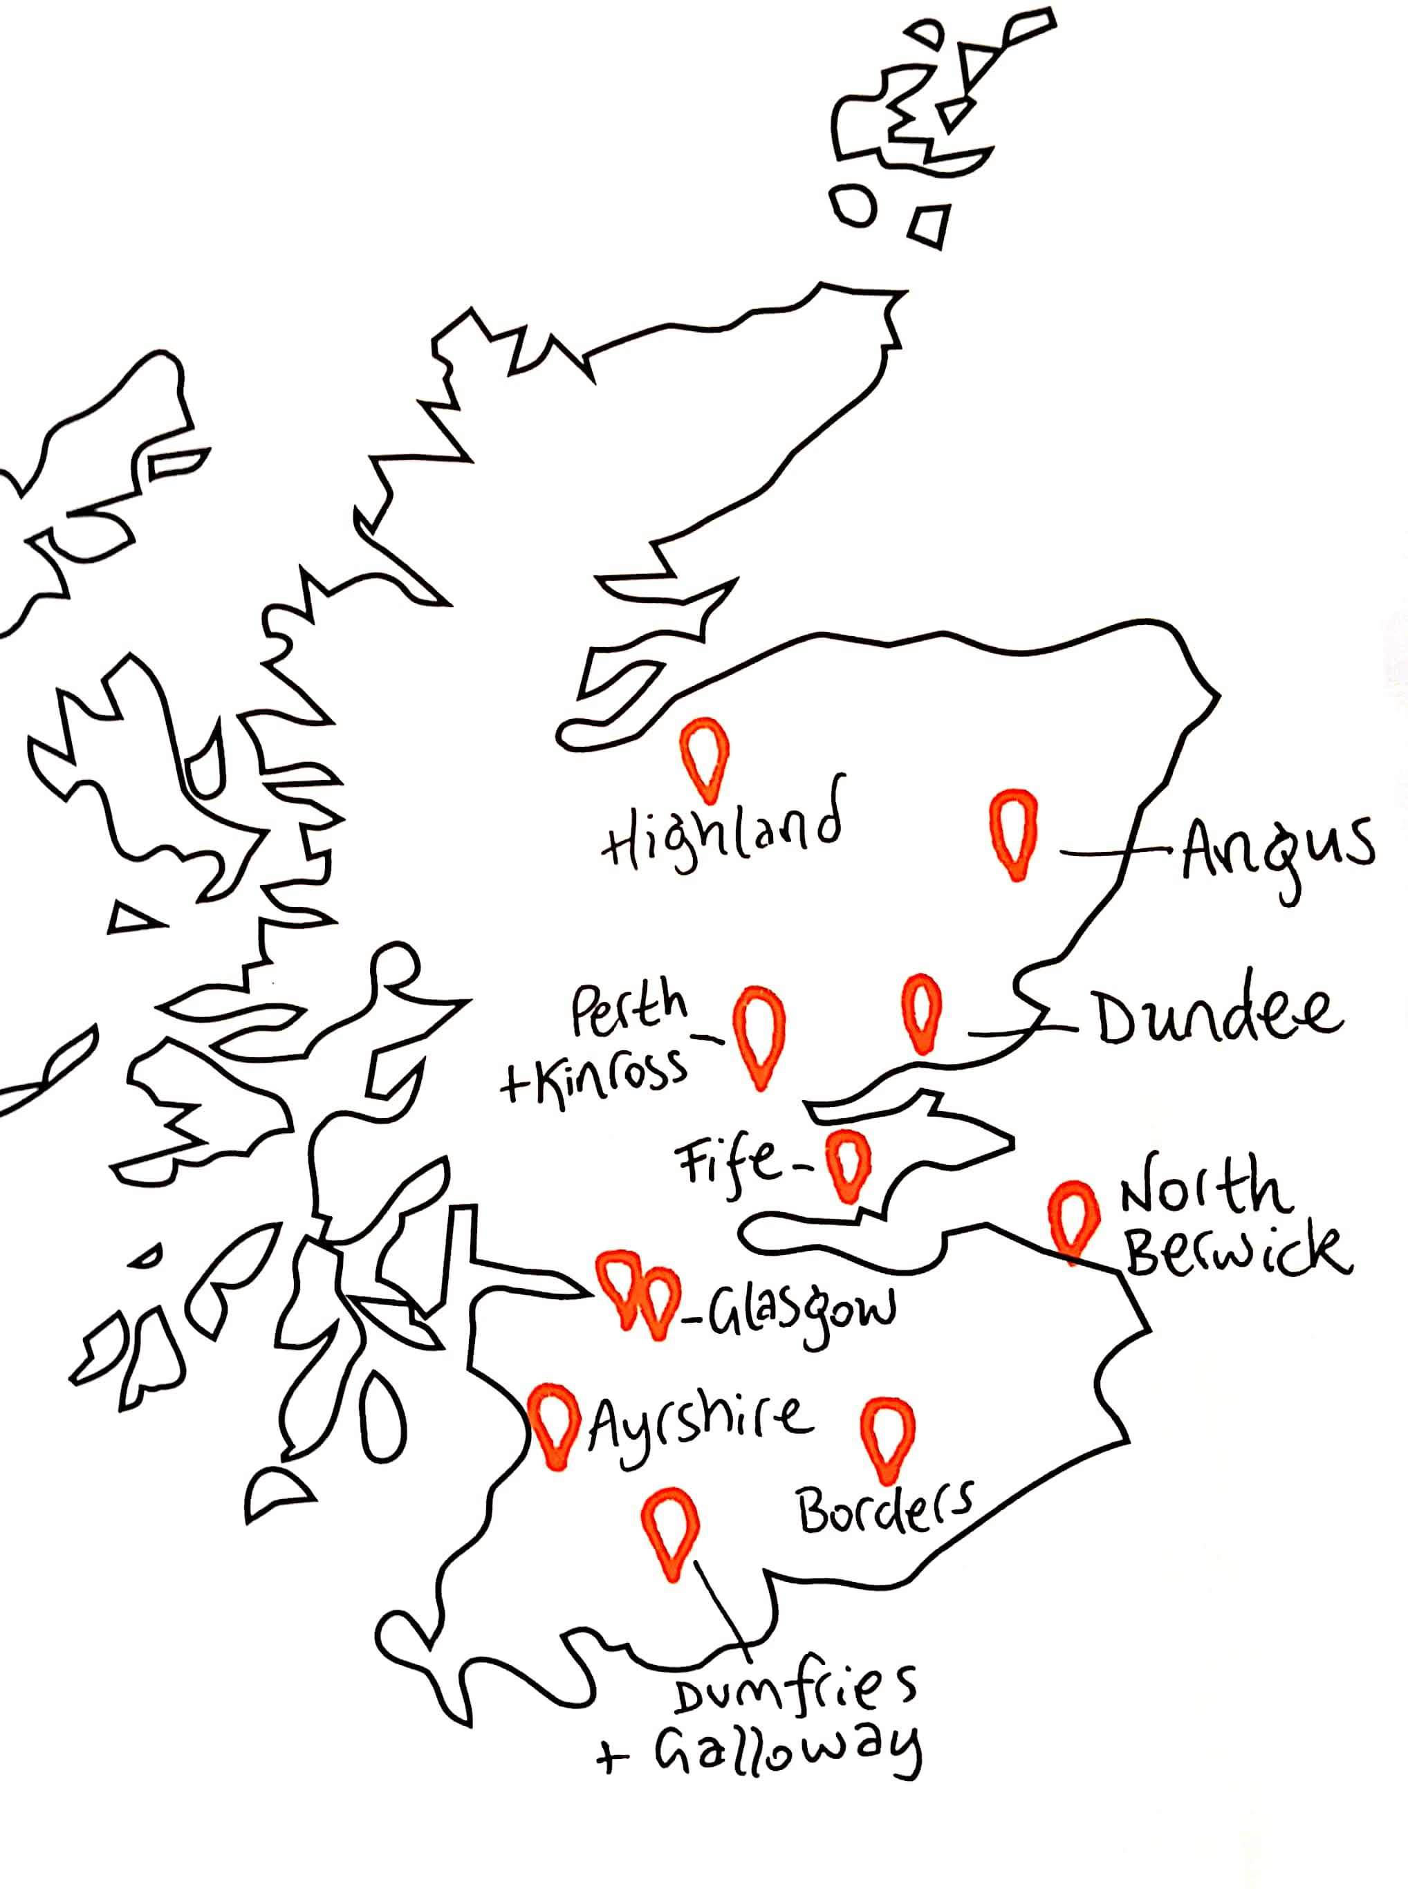
Notes:
Truacanta Process
Launched in May, expressions of interest
Eleven shortlisted
Shortlisted groups asked to embrace community development approach right away
No application form – not about right answer in right box
Working on vision for change
Different outcome for some, but everyone embracing the coddiwomple

Slide 23
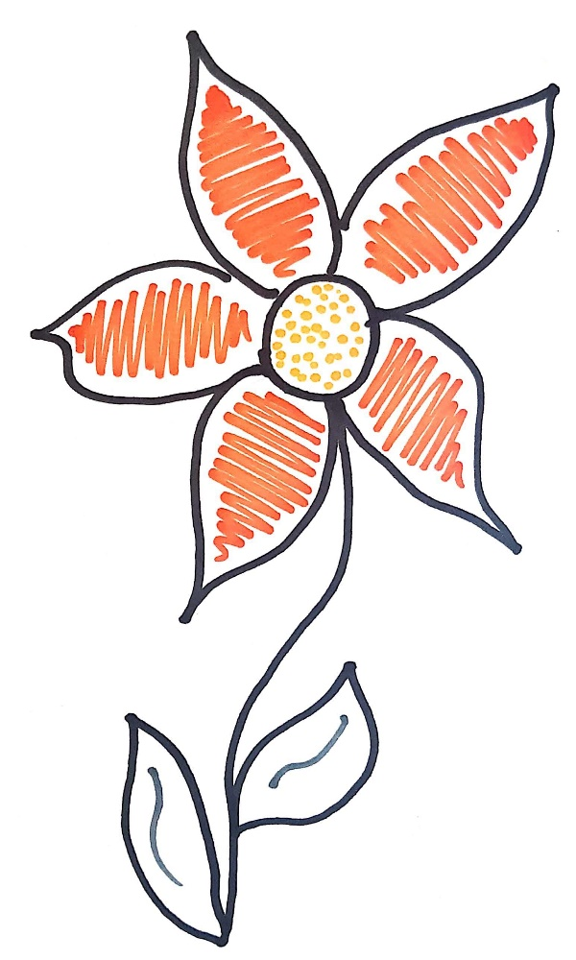
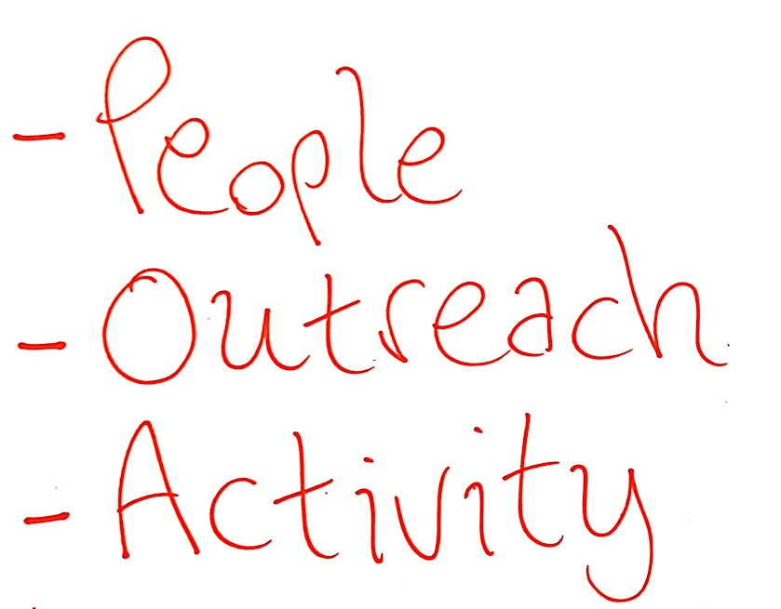
Notes:
Vison for change can be a bit overwhelming – again, that vague destination
Can be broken down into three areas
People – who is involved in the planning, development, delivery; who will benefit
Outreach – who else should be involved? Making sure everything is accessible and inclusive
Activity – what will work for your community
~Each community has spent the last few months working on that
Finding ways to start the conversation
Make sure the process is community led and owned

Slide 24
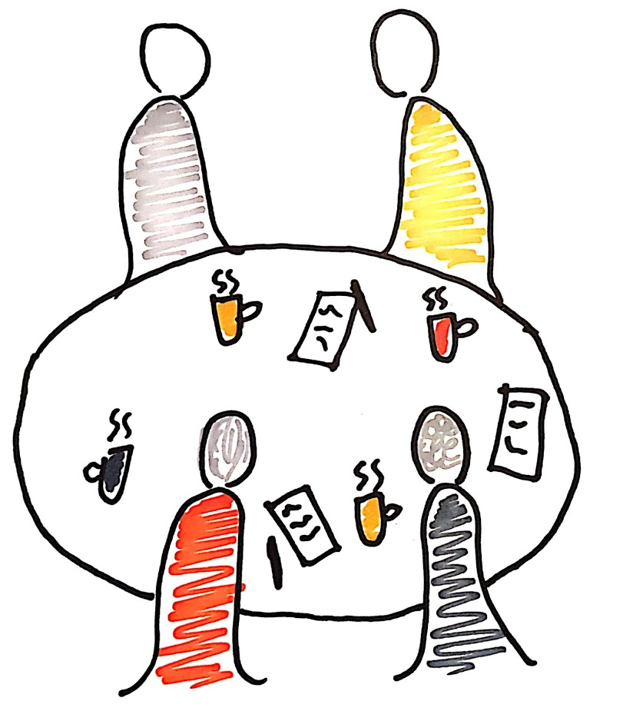
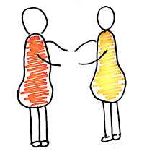
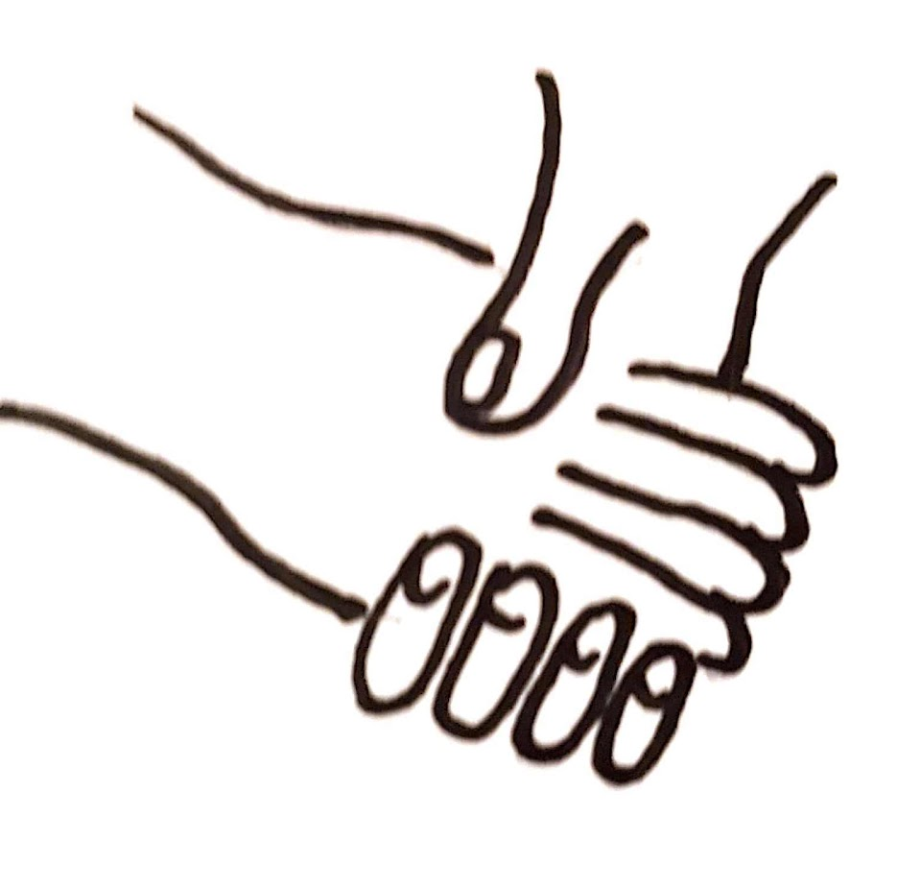
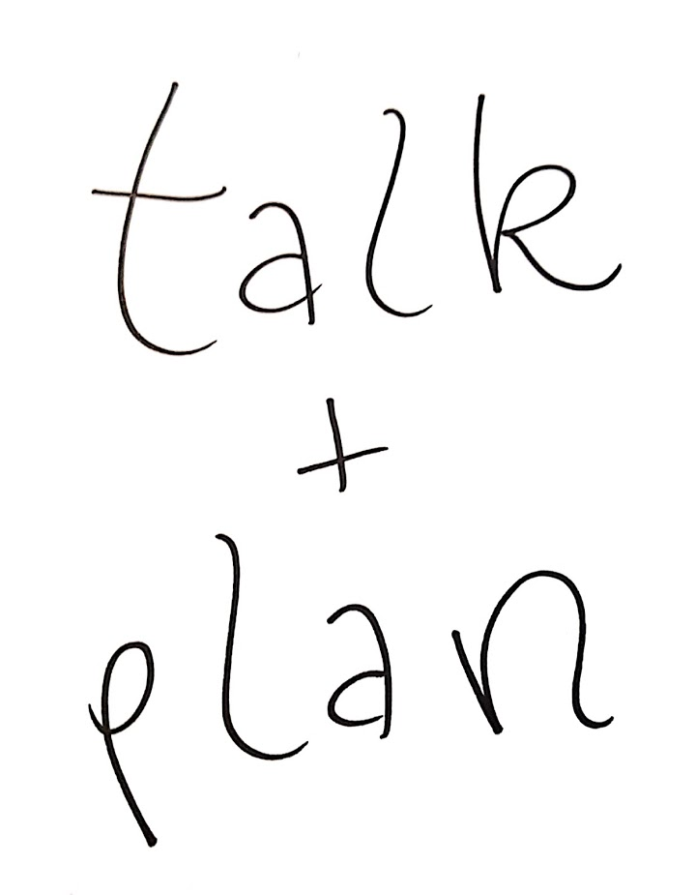
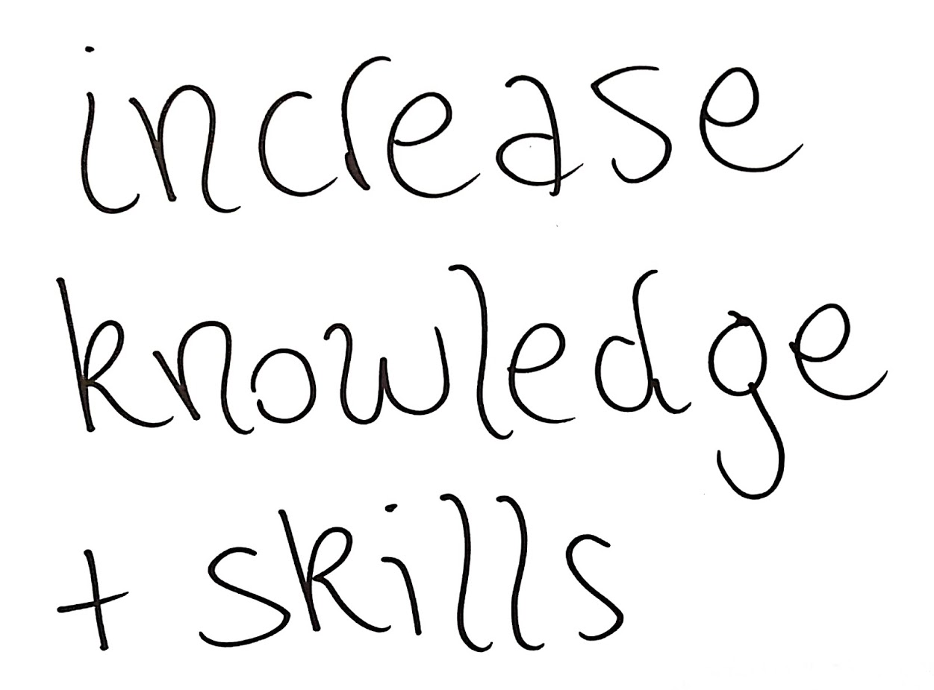
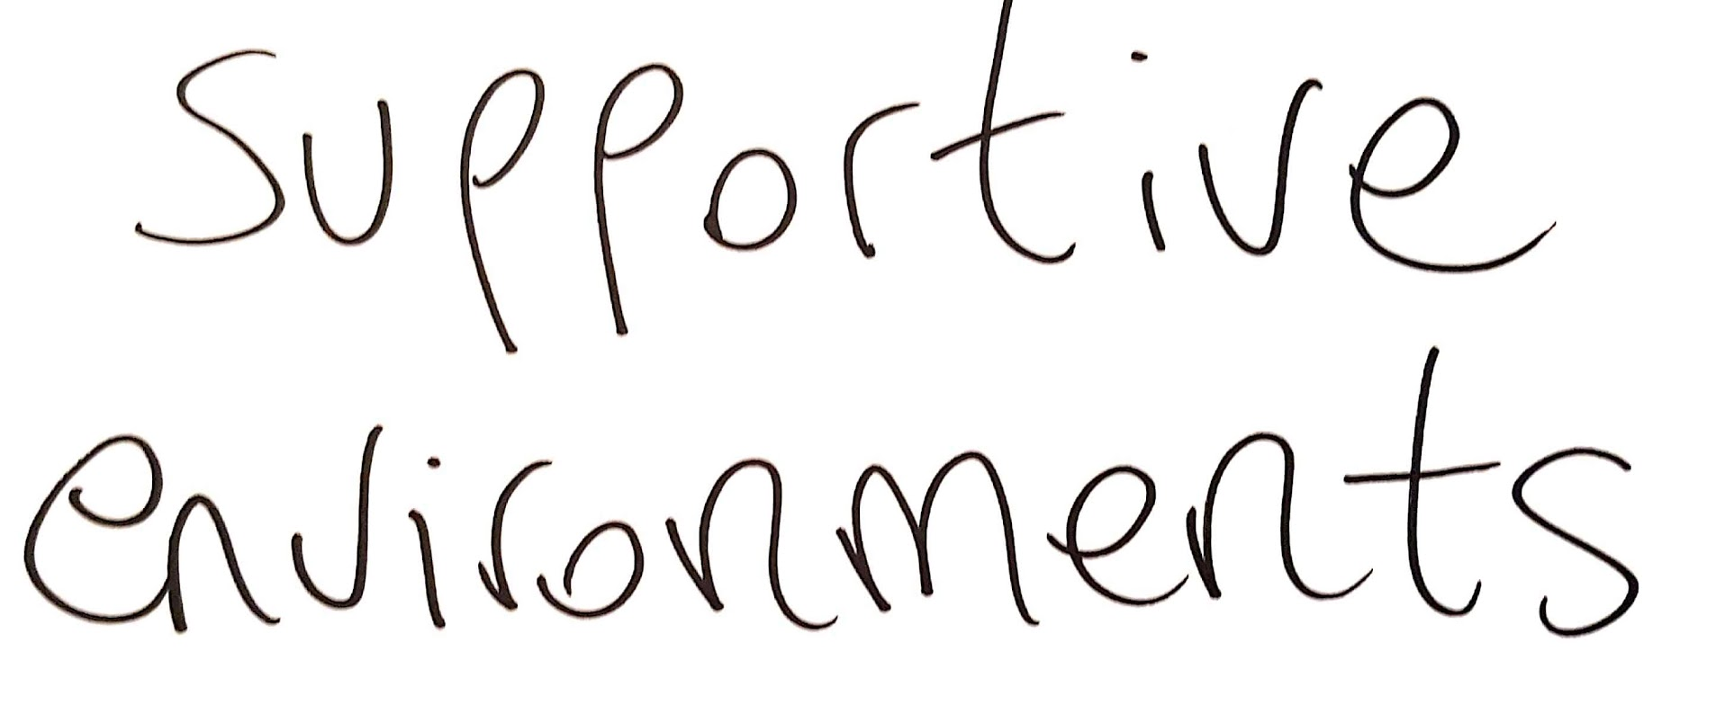
Notes:
Lots of different and creative ways
Events in various communities – gathering in church hall, arts activity in local café
Enthusiasm for compassion and kindess
Desire to help each other through difficult times – whether around end of life planning,
better bereavement support, or simply making death & dying a part of everyday conversation

Slide 25
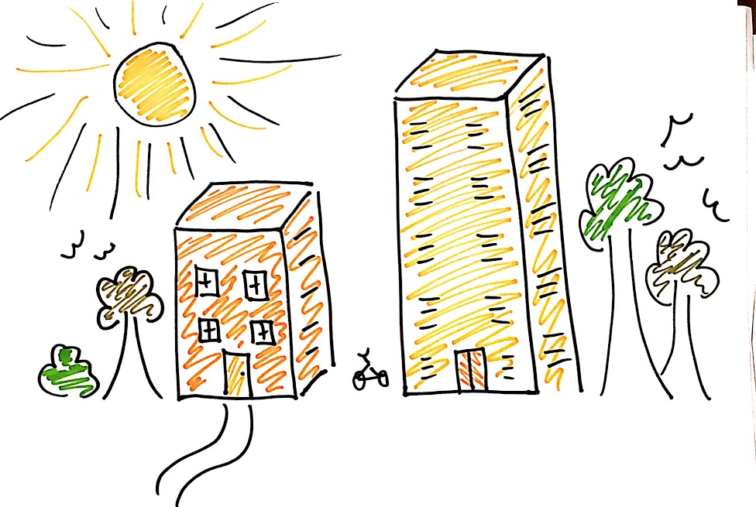
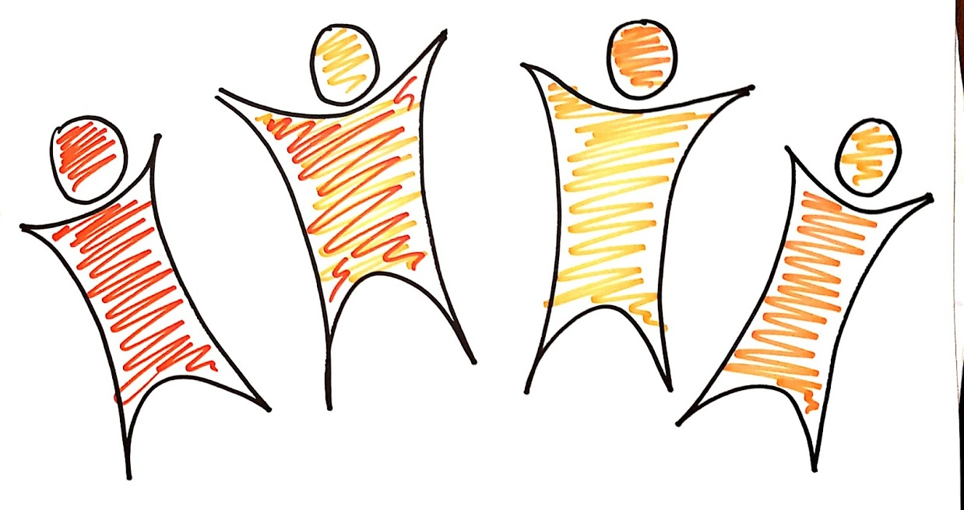
Notes:
Each community is unique, with different needs and their own assets and resources, so each vision will be different
But they are all united in the belief that together, we can do death better.
I feel very privileged to be supporting communities to work towards that.

