Slide 1


Good Practice Examples
Scottish Compassionate Communities Toolkit
Rebecca Patterson & Robert Peacock
Good Life, Good Death, Good Grief
Notes:
Hello again. So, earlier I mentioned that we’ve spent some time looking at what other people have done to try to make communities better at supporting each other with death, dying and bereavement, and we’ve brought some of these ideas together on to a website, which we’ve called the Compassionate Communities Toolkit.

Slide 2

Scottish Compassionate Communities Toolkit
A collection of resources providing ideas and information aiming to be of practical use to people wishing to make their local community more supportive of people going through difficult times that can come with death, dying, loss and care.
Notes:
Basically the website is designed for anyone who is interested in making their own community more supportive of people going through difficult times that can come with death, dying, loss and care.
It brings together, examples, ideas and information aiming to of practical use to people who want to make change happen.

Slide 3
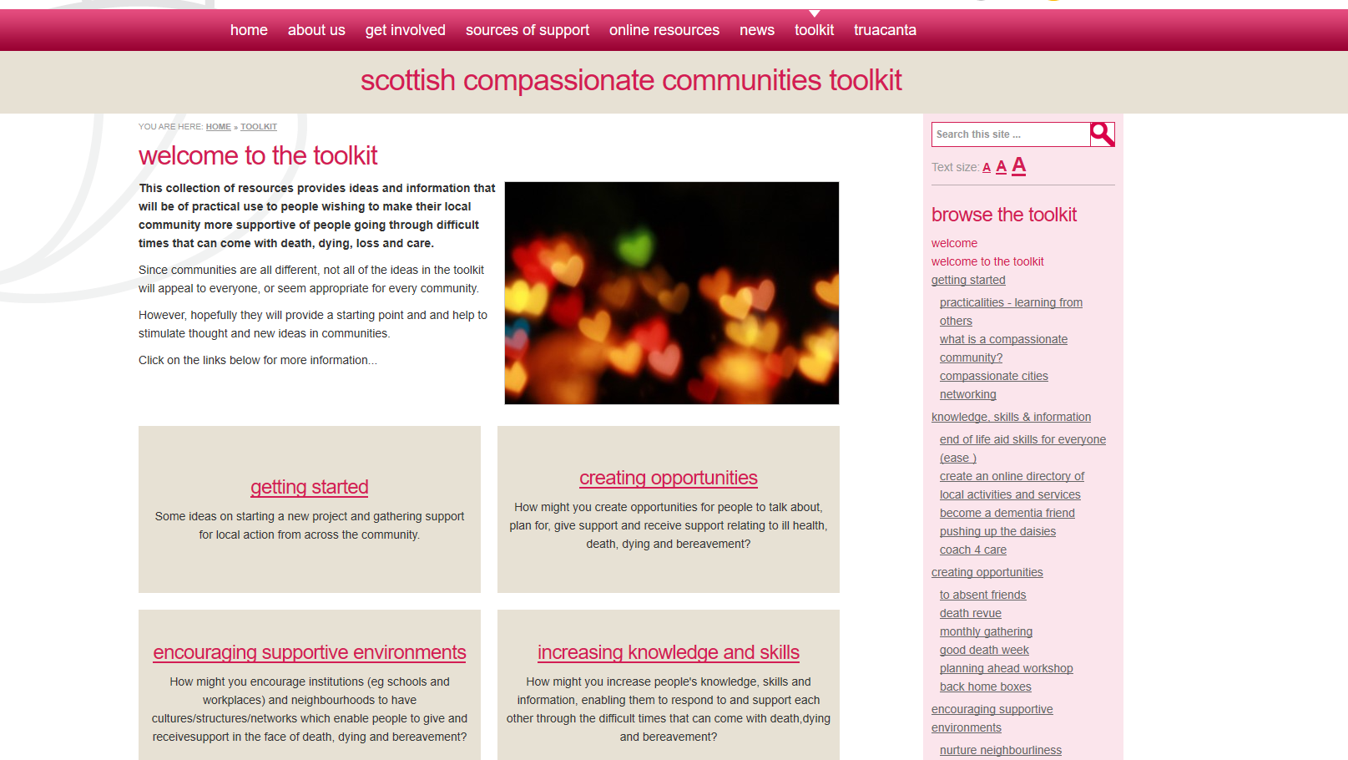
www.goodlifedeathgrief.org.uk/content/toolkit_homepage/
Notes:
This is what the website looks like.
It has sections exploring how a community can go about getting started in this area,
How a community can look to increase its knowledge, skills and access to information
How a community can create opportunities to give and receive support, and to talk and plan for death.
And also some ideas about how to change cultures, structures and networks to enable good things to happen.
You can check it out yourself at this link if you wish.
But we just wanted to highlight a few examples from the toolkit that might be particularly interesting for church communities

Slide 4

Coming up…
Practical examples of actions people have taken…
Creating opportunities to
  give and receive support
  talk about and plan for death
Increasing knowledge and skills – public education course
www.goodlifedeathgrief.org.uk/content/toolkit_homepage/
Notes:
So, I’m going to hand over to my colleague Robert Peacock, and he’s going to explore some practical examples of things people/communities have done to create opportunities,
Then I’ll come back and talk a bit about a new public education course that some of you may be interested in.

Slide 5
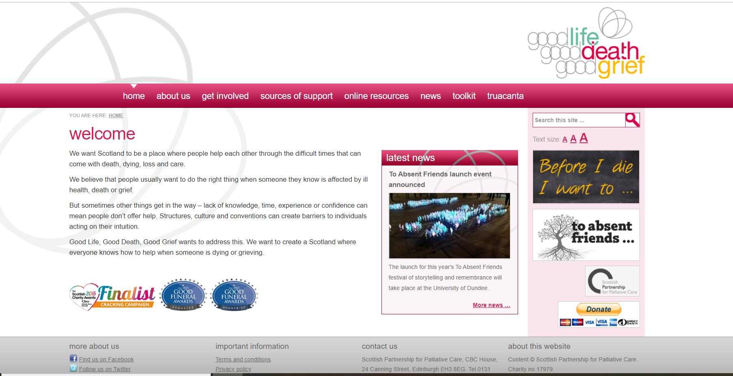
Creating opportunities for support

Slide 6

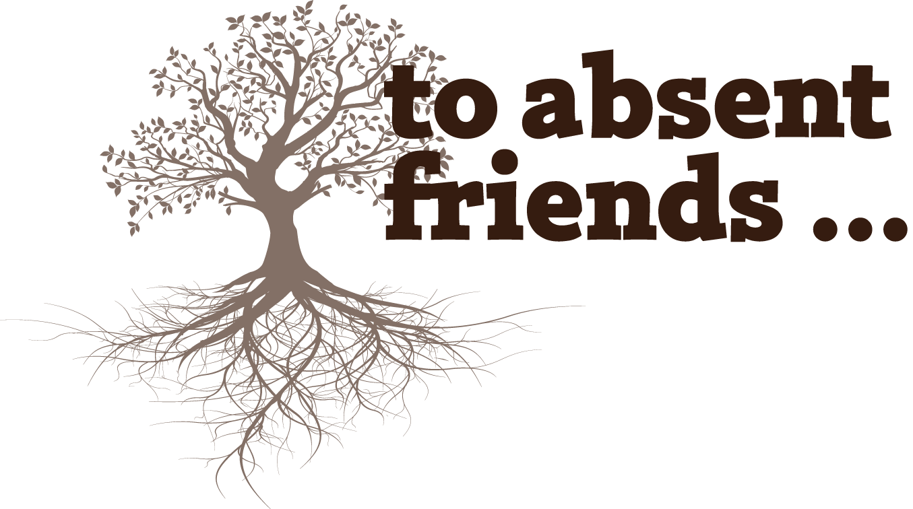
Scotland’s people’s festival of storytelling and remembrance
1-7 November
PROMO VIDEO
Notes:
To Absent Friends, the people’s festival of storytelling and remembrance, is an event we established in 2014 to give people an opportunity to talk about and remember those they have loved who have died. [Usual stuff about November being time of remembrance…]
Don’t need to hear from me about it, here are some of the people who have participated in it to tell you what it means to them.
Among the organisations who have held events for TAF are various church groups.

Slide 7
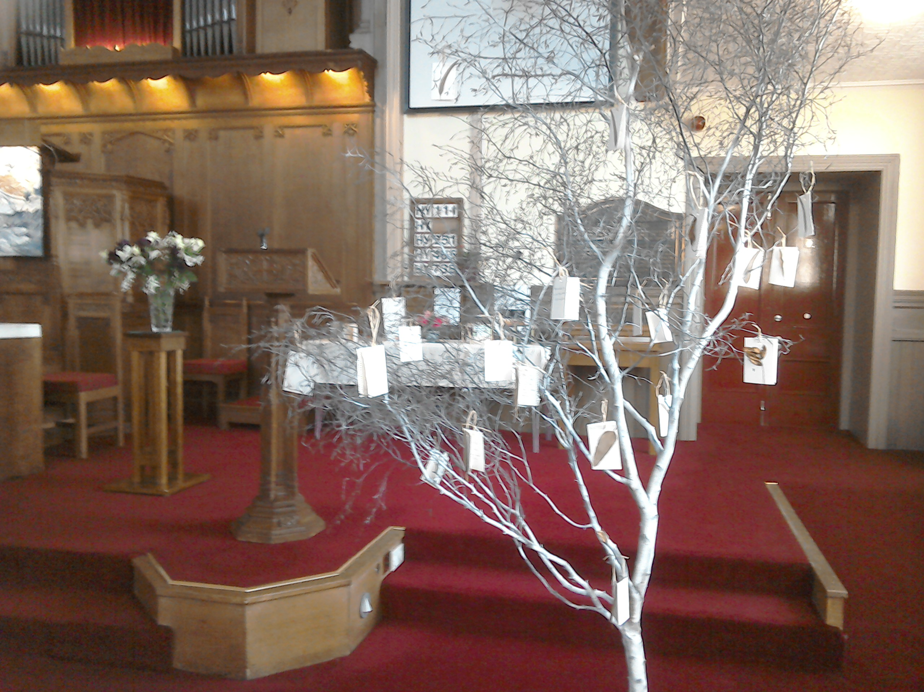
Wardie Church, EDINBURGH
Tree of Remembrance
Memory Box workshop
“It was clear that for some of those who came into the sanctuary it was a significant experience: one person said it was the first time she had been able to face coming back into church since the death of her husband three years previously.”
Notes:
Activity based remembrance

Slide 8
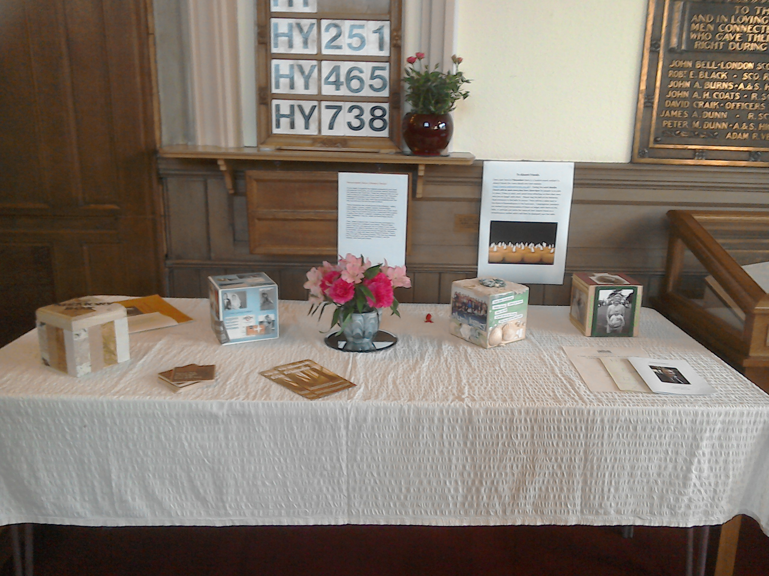
Wardie Church, EDINBURGH
Tree of Remembrance
Memory Box workshop
“It was clear that for some of those who came into the sanctuary it was a significant experience: one person said it was the first time she had been able to face coming back into church since the death of her husband three years previously.”
Notes:
Activity based remembrance

Slide 9
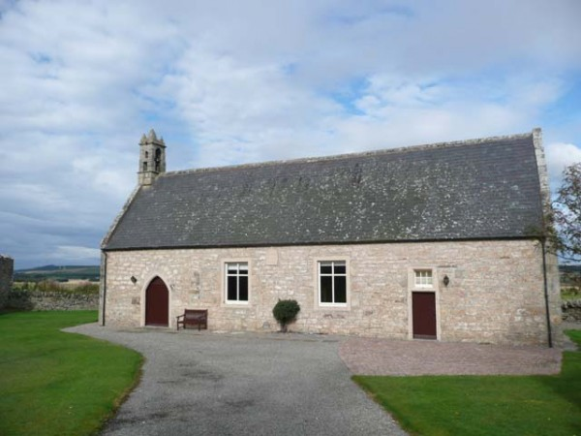
Spynie Kirk, ELGIN
Open church
Quiet, reflective music
Tea lights
“One participant said she was very grateful for the opportunity to sit, listening to music and reflecting – particularly remembering a family funeral going on that day that she was unable to attend. Others commented on welcoming the chance to sit and reflect. ”
Notes:
Reflective activities

Slide 10
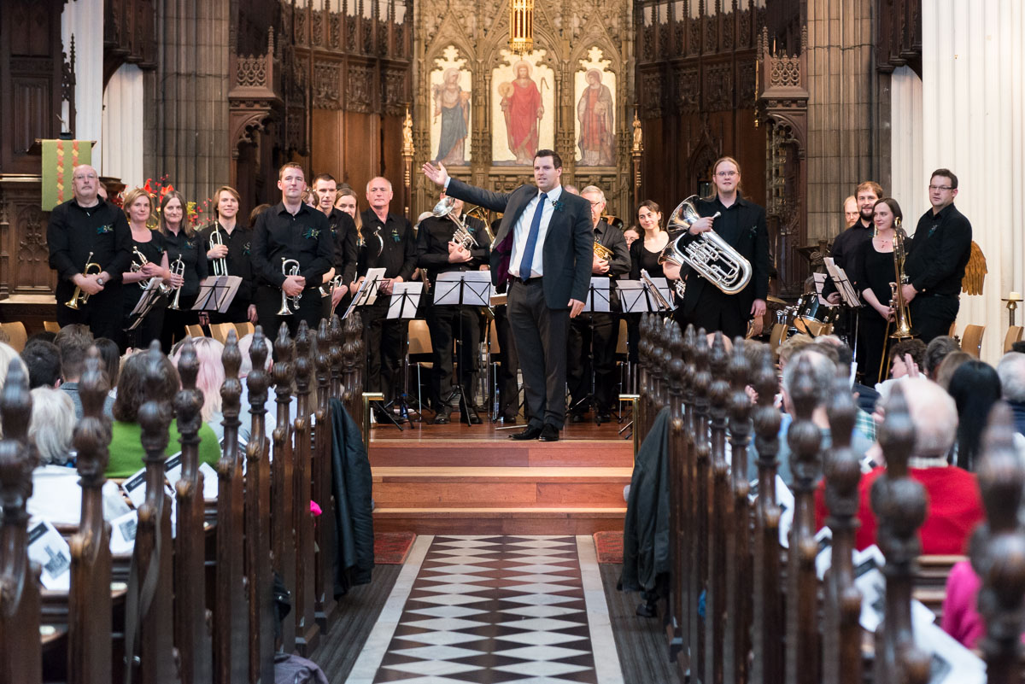
St John’s Church, EDINBURGH
Edinburgh Brass Band concert
“Edinburgh Brass Band had such a great experience participating in this festival. It has been the most requested concert by members of the band and their families and friends.”
Notes:
Hosting others

Slide 11
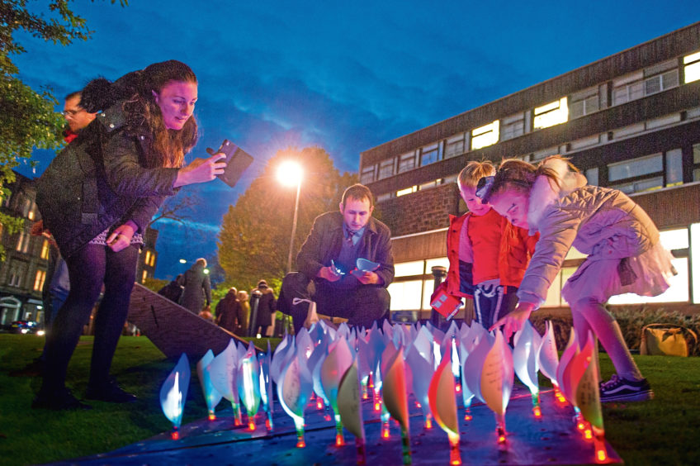
Other ideas
Illuminated Lily Garden
(Dundee University. Photo: DC Thomson)

Slide 12
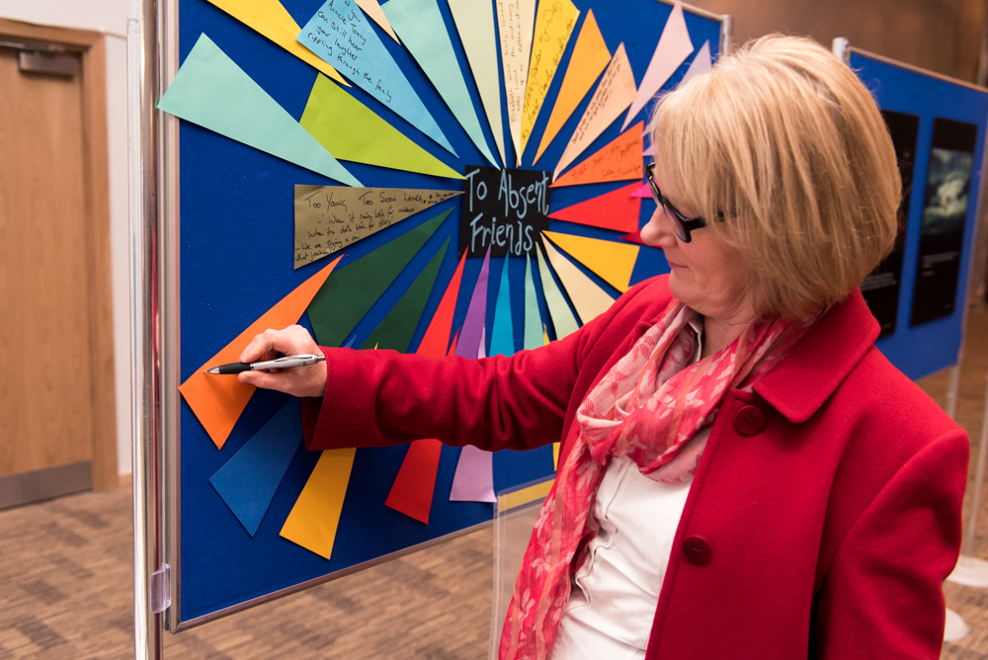
Other ideas
To Absent Friends wall
(RSNO at Royal Concert Hall, Glasgow)

Slide 13



Falkirk Trinity Church
Four sessions of 2 ½ hours
Informal, relaxed
Not counselling or therapy
Trained ‘companions’ facilitating small groups
Peer support
Loss and grief are a normal part of life
Grief is cyclical, not a linear journey
“I have enjoyed the companionship, the sincerity and the honesty within the group”

Slide 14
Creating opportunities to talk and plan

Slide 15

Death Cafes

Slide 16
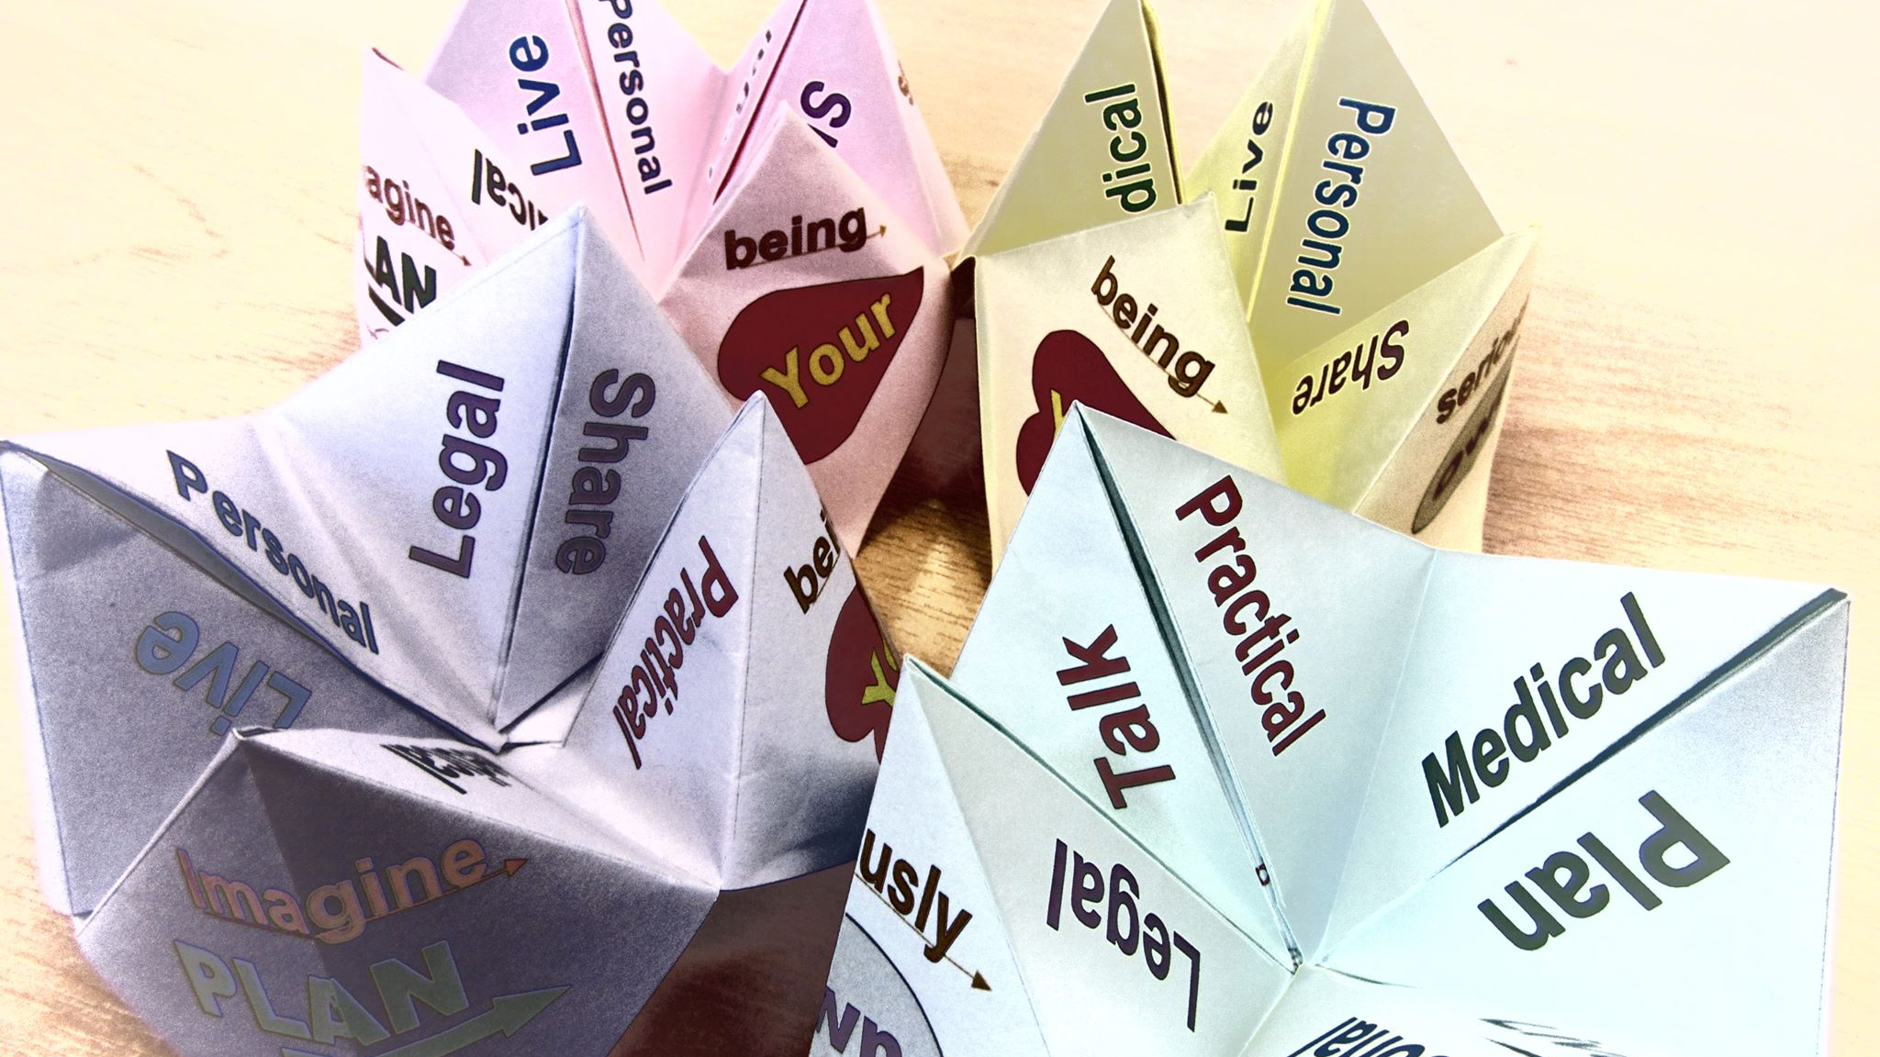
Origami Game

Slide 17

Grave Talk

Slide 18
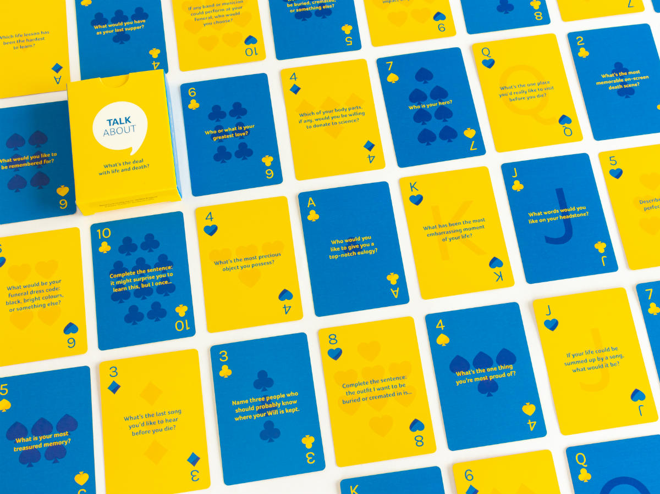
Marie Curie Cards

Slide 19

End of Life Aid Skills for Everyone (EASE)
Building comfort and confidence to support people through dying, death and bereavement.
Notes:
Hello again.
So, I’m going to move on to thinking about increasing people’s knowledge, skills and access. Obviously one way of doings is through education, and I wanted to tell you about a public education course we’re developing, called EASE.

Slide 20

Aims
to enable ordinary people to be more comfortable and confident supporting family/community members with issues they face during dying, death and bereavement.
Notes:
This is a brand new course that we just finished piloting in Edinburgh and Dundee last week.

Slide 21

Target Audience
Anyone who wants to be able to support someone with issues they face relating to death, dying and bereavement, including:
People who are carers
People who expect to soon be carers
People who want to be prepared to better support others.
Notes:
The course is for anyone who wants to be able to support someone with issues they face relating to death, dying and bereavement. This is likely to include:
People who are caring for family or friends whose health is deteriorating and who are likely to die.
People who expect to soon be caring for family or friends experiencing declining health and who are likely to be approaching the end of life.
People who might not currently have caring responsibilities but who wish to be equipped to provide basic support for friends, family or community members who are either approaching the end of life, or who are supporting someone who is.

Slide 22

What should be covered by an End Of Life Aid Skills for Everyone course?
What does the literature say?
Notes:
We looked at the literature
From this we got an idea of what professionals and organisations think that the public should know.

Slide 23

What do members of the public want to know?
Navigating the health and social care landscape
What formal health & social care support is available (and what isn’t)
How the health and social care system is structured
Rights to access support or to refuse medical intervention
Advocating for someone who is ill
Notes:
Lack of familiarity with some of the issues that commonly arise
Navigating the health and social care landscape
What formal health & social care support is available (and what isn’t)
How the health and social care system is structured
Rights to access support or to refuse medical intervention
Advocating for someone who is ill
From this information we set about developing learning outcomes that reflected what people said they wanted to know. From there, we have now drafted the following four modules. We expect each of these to take roughly 2 hours to complete:

Slide 24
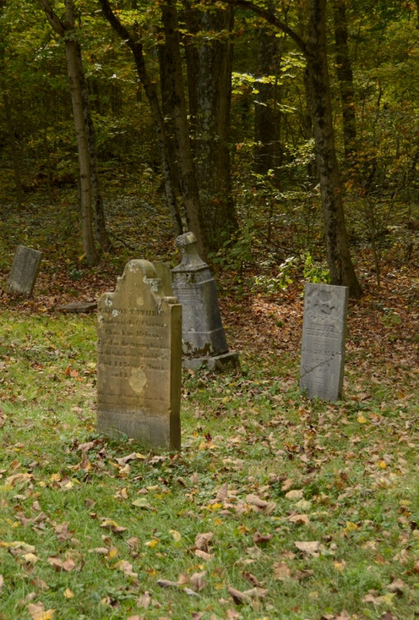
Module 1: An Introduction to Death in Scotland
This modules gives people an opportunity to grow more comfortable talking about death and dying, and explores common illnesses and patterns of decline. It looks at the roles of different professionals and institutions and the responsibilities and limitations of Scotland’s health and social care system.
Notes:
Part 1: Getting more comfortable talking about death and dying
Part 2: What are the main causes and places of death?
Part 3: Navigating the health and social care system
Part 4: Expectations and Reality

Slide 25

Module 2: Serious Illness and Frailty
This module looks at some common issues that can arise towards the end of life and some of the emotional issues that can affect someone who is dying. It explores the emotional support a friend or family member can provide to someone who is dying. It also looks at what people can do to plan ahead to improve their end of life care experience.
Notes:
Section 1: Communication skills: self awareness
Section 2: Common issues arising to the end of life
Section 3: Planning ahead for illness and death
Section 4: Emotional and spiritual aspects of dying
This module looks at some common issues that can arise towards the end of life and some of the emotional issues that can affect someone who is dying. It explores the emotional support a friend or family member can provide to someone who is dying. It also looks at what people can do to plan ahead to improve their end of life care experience.

Slide 26
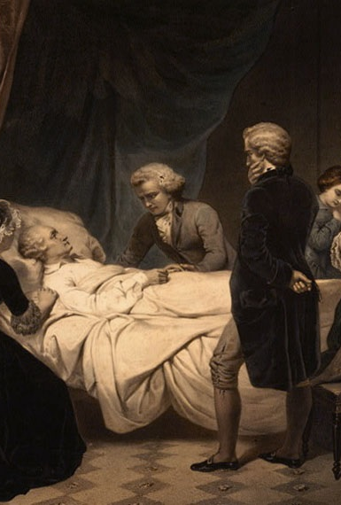
Module 3: Realities of Caring and Dying
This module explores some of the common bodily changes that take place in the last few days and hours of life. It covers common treatments and medications that someone might come across, and expectations relating to what these treatments can achieve. This module also looks at the practical support a friend or family member can provide to someone who is dying.
Notes:
Part 1: Providing help and support when someone is very ill
Part 2: Medicine and Treatment
Part 3: Providing help and support
Part 4: The moment of death

Slide 27

Module 4: Caring for the Carer
This module explores some of the issues that can affect people who are spending a lot of time looking after someone else, and where to get more information, help and support. It covers bereavement, emphasises the importance of self-care, and looks at how people can look after themselves and others they know who are carers.
Notes:
Part 1: What issues can affect carers?
Part 2: Where can carers get information and support?
Part 3: How can you help someone who is a carer?
Part 4: Bereavement
Part 5: Looking after yourself.

Slide 28

PowerPoint slides
Handouts
Activities
Discussions
Films
Facilitated not taught

Slide 29
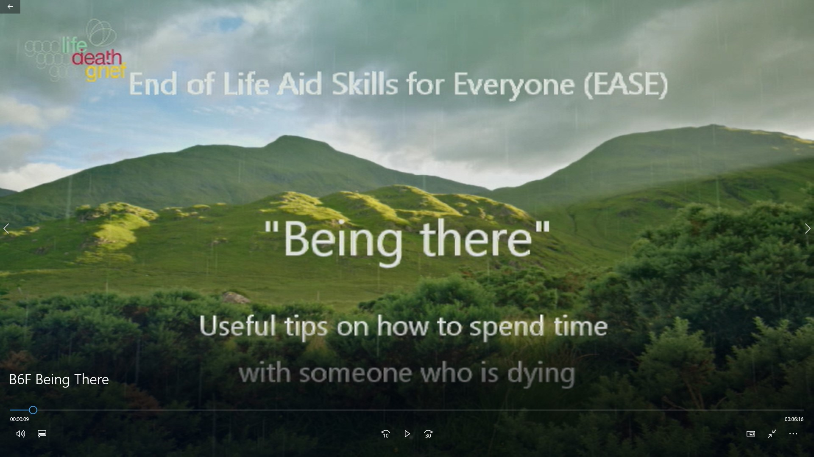

Slide 30
What will you take away from tonight’s session?
Positive message: we can all do something to help a good death happen.
Not to be intimidated by medics but to learn the language, to respectfully challenge silence.
Expectations and reality rarely match but can do things to bring them closer.
The “innate ability” to help support someone at end of life.
How to better influence care/decisions.
Need to think more about own Advance Directive/Death Plan.
A sense of all of us being strong in being a community to deal with aspects that could be improved in end of life care.
Notes:
So that was one example of a film that we’ll show during the course, and we have others on a variety of topics. So far we’ve received really great feedback from the people who have participated in the course, and it would seem that people really value the range of activities and discussions in the course.

Slide 31
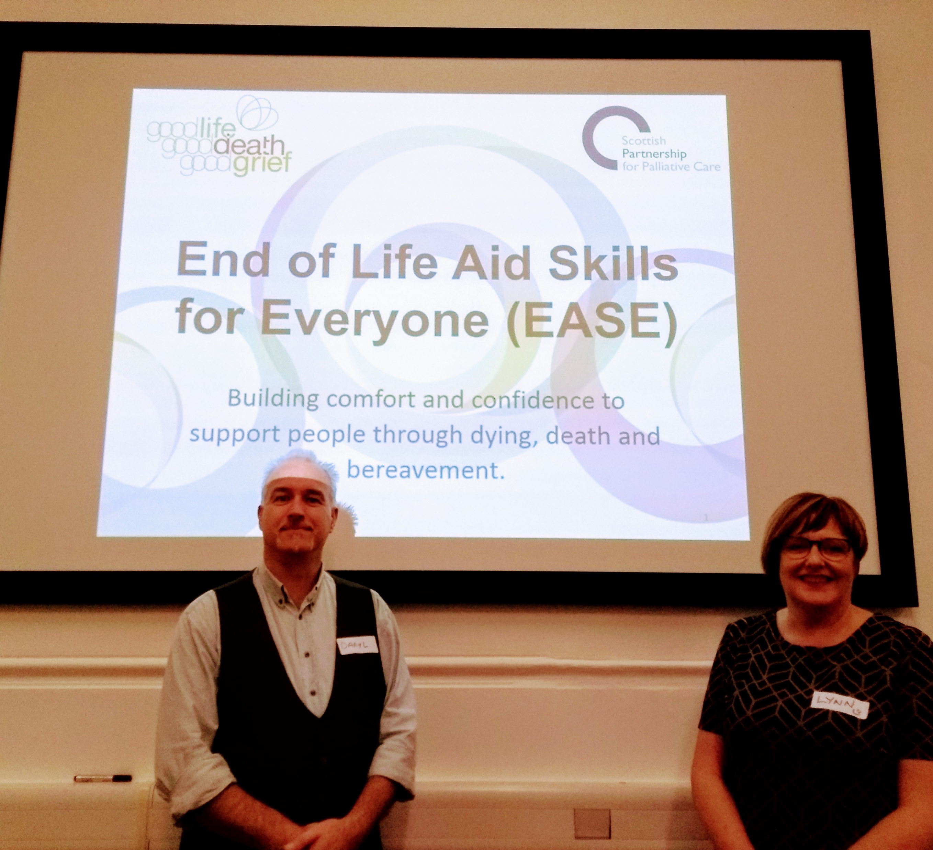
Free to access
Groups of 12-15 people.
2 volunteer co-facilitators lead each session.
Course facilitators attend training and receive some kind of accreditation.
Notes:
Our vision is that the course will be free to access, and led by volunteer facilitators, who will attend training and receive some kind of accreditation. The idea is that skilled and sensitive people can train and then go on to deliver these courses in their own area.

Slide 32
Get in touch
If you’d be interested in running/ participating in EASE courses in your area email:
rebecca@palliativecarescotland.org.uk
Notes:
We’re hoping to start making the course available in the summer next year. We hope that a range of people and organisations will be interested in participating in and potentially delivering the course in their area, so if that’s something you think you might be interested in, please get in touch –

