Slide 1
Human rights and spirituality: ‘a veil as thin as gossamer’ The Malcolm Goldsmith Lecture 2021
Dr Donald Macaskill

Slide 2
The human rights and spirituality ‘clash’
The religious roots of human rights understanding
The modern human rights movement
The individual and the communitarian
Human rights in social care practice
Towards a spirituality of human rights

Slide 3
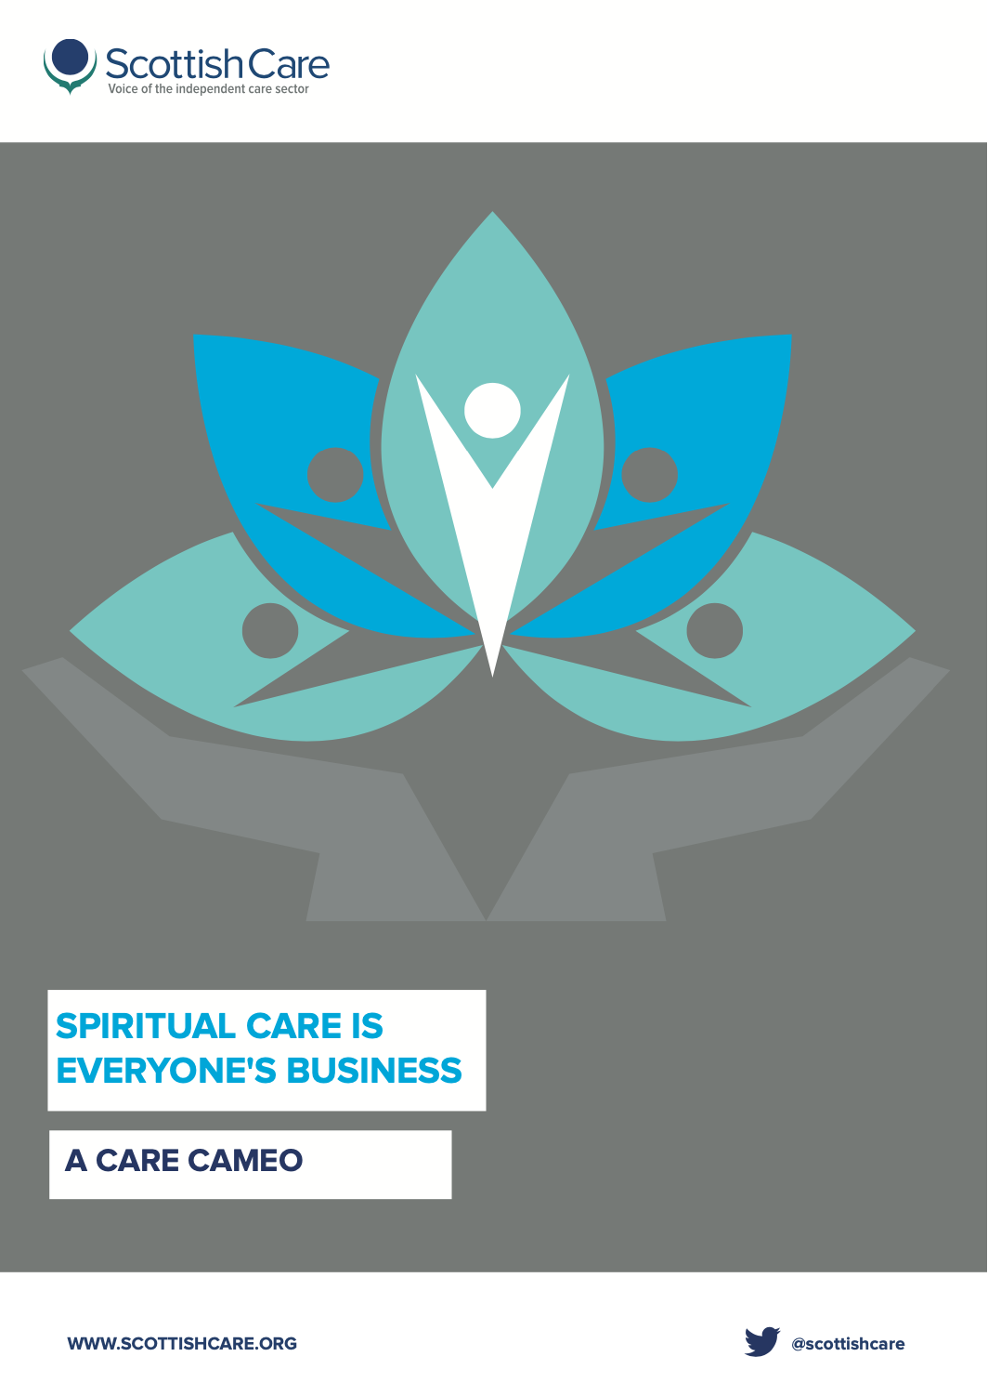
Froggett and Moffett:
“We mean the search for that which gives zest, energy, meaning and identity to the person’s life, in relation to other people and the wider world.”

Slide 4
World Health Organisation:
‘that health is not just the absence of disease but is a state of physical, psychological, social and spiritual well-being.”

Slide 5
Mona Siddiqui:
‘Religious ethics must complement, not clash, with the rights-based discourse using a language that is meaningful, not just authoritative. Only then will religion surface forcefully and justly as a public good rather than simply a private passion.’

Slide 6
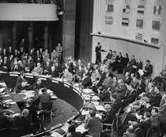
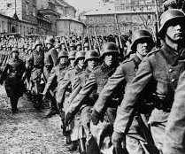
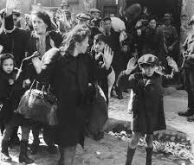
They wanted to make a statement and to create a movement which would bind themselves one to the other in a way which would mean that the world would never again have to endure the horror which it had come through and with millions still homeless and desolate was still enduring

Slide 7
There is a profound issue of spirituality in enabling individuals to exercise their autonomy and choice, their rights as human individuals around decisions which prolong life.
This is where legality and spirituality need to converse.

Slide 8
Dustin N. Sharp
‘Ultimately, such a spiritual perspective lays the predicate for a more intimate, relational view of human rights as an ongoing dialogue between self and other, and between the individual and the community, in which the key props and protagonists of the mainstream human rights story— the machinery of the state, the United Nations, the lawyers, the experts, the treaties, the INGOs— become less central.’

Slide 9
‘[Human rights] are indeed frameworks of law, ethical principles and foundations, but their gift to us is that they proffer us a new way of being in relationship one with another. They picture a humanity which is shrouded in the nakedness of dignity. They depict a biological and environmental wholeness and holism at their heart.

Slide 10
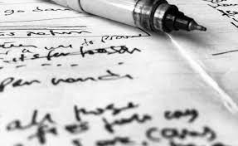
for her truth was always told, insight was always heard, mystery was always seen, love was always felt …
when I asked her why she never wrote things down, she said she had never discovered paper which didn’t trap the words.

Slide 11
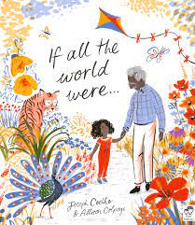
If all the world were paper
I would fold up my gran and take her everywhere I go.
I would laminate my baby sister in bubble wrap
and lay her to sleep in unbound fairy-tale book pages
and should she get scared: Rip every fear, Shred every scream, Tear every tear.
---
If all the world were paper we could paperclip families together, draw smiles on all the sad faces, rub out the tears, cover our homes in Tipex and start all over again.
All the world is not paper but whilst we can imagine it were we can recycle the rough times knowing we will never – ever fold.

