Slide 1
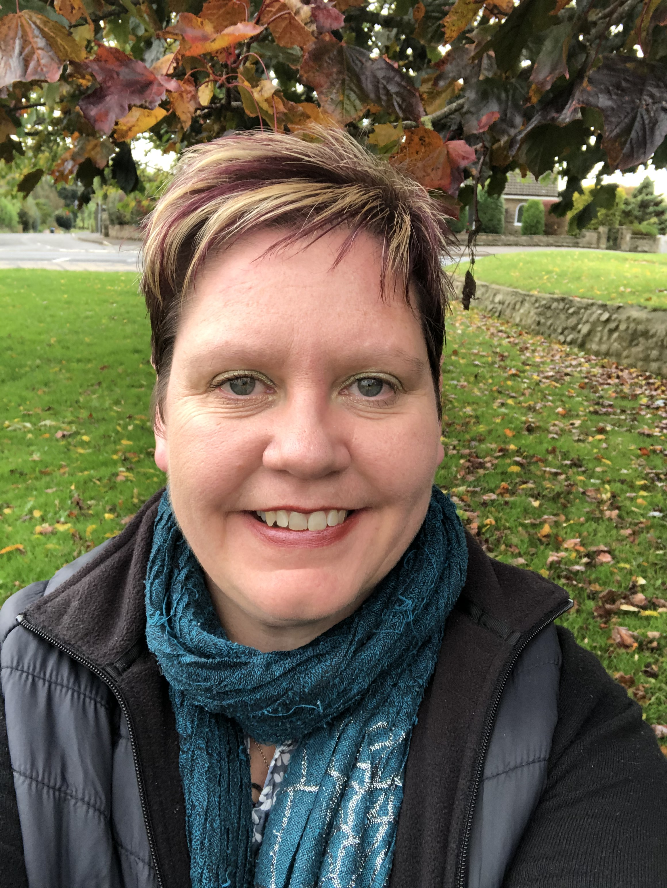
The importance of ministry to and with older people- The Harvest Field influenced by the ‘silver economy’
Helen McCormack
Pastoral & Development Worker
for Older People
Thirsk & Northallerton Methodist Circuit &
Zion URC Northallerton
Mobile: 07751 078506
Email: helenmethodisturc@outlook.com

Slide 2
Overview
2019 – Good things happen over coffee A year of networking
2020 – It’s Good to Talk A year of listening and talking
2021- ‘Life goes on’ Lamenting & Reconnecting

Slide 3
Setting the Scene
James Woodward, a pastoral and practical theologian coined a phrase
“Harvest of Life “ He highlights how each individual has their own story to tell that makes up the harvest of life.
Older people are not one homogenous group rather they are made of a diverse group.
Third- Age – Those who are retired and active
Fourth Age- Is when frailty increases, and physical & cognitive decline reducing the person’s capacity to live actively.

Slide 4
1. Look at the wider ageing agenda 2. Ageing from a Christian Viewpoint 3. The role and benefits of spirituality 4. How is the Harvest Field influenced by the ‘Silver Economy ?’
4 Sections

Slide 5
Ageing Agenda
Ageing Population often valued for their economic contribution and what they spend.
Development of the term ‘Silver Economy’
A culture of deny the ageing process.

Slide 6
Ageing Agenda
Age UK Later Life Research on
Over 65’s Contribution to Caring Responsibilities for both children and adults & Voluntary Sector
WHO The Decade Of Healthy Ageing 2020-2030
Ageing Friendly Initiatives

Slide 7
Ageing Agenda
Church Attendance in 2000 over 65’s made up 25% congregation.
Predicted by 2030 45% of church goers will be over 65

Slide 8
What Makes us human?

Slide 9
Being Valued
Age Scotland & Scoinform-The Big Survey (September 2021)
The results revealed that only one in five older people (21%) feel “valued”, while more 36% believed they were a burden on society. 51% of over 50’s said ‘Older People are not valued for their contribution to society’

Slide 10
Human Beings – Created in the Image of God Valued Relational Beings Interdependency and relation care Intergenerational
Christian Perspective

Slide 11
Spirituality – Basic Human Need
Ageing is a journey
Every human includes a spiritual dimension H Mowatt (2013)
Who Am I, Why am I here?
The need to be loved
The need to belong
The need to feel hope, peace & gratitude

Slide 12
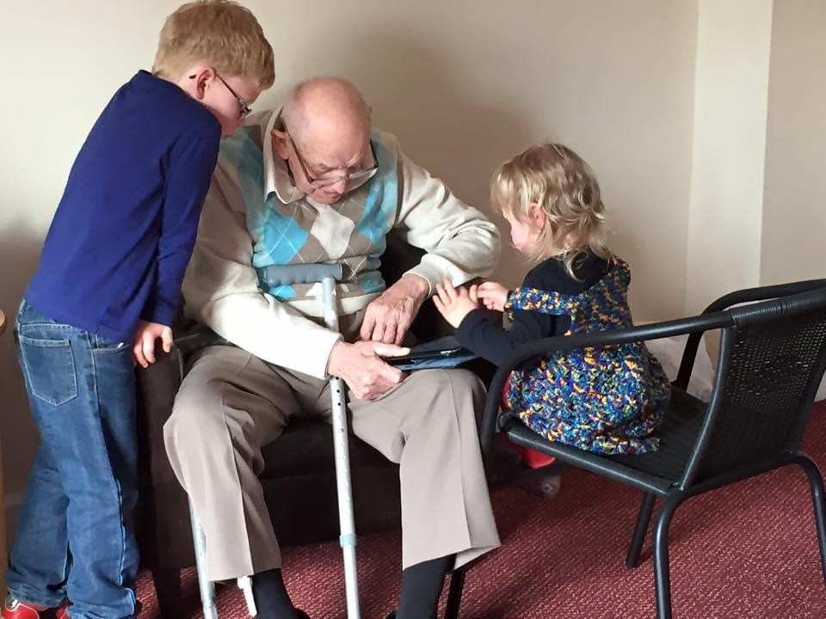
Storytelling
“Our stories tell us who we are, where we have come from, our connection with one another, and to the land”
The Scottish Story Telling Forum

Slide 13
Storytelling & Dementia
Professor John Swinton of Practical Theology
“We often understand our personl identity according to the story we tell about ourselves. Howevet, once we can no longer do that, we forgot history. The wider culture says that ‘you are losing yourself’. The Theological story says no that’s impossible: God wont lose you”

Slide 14
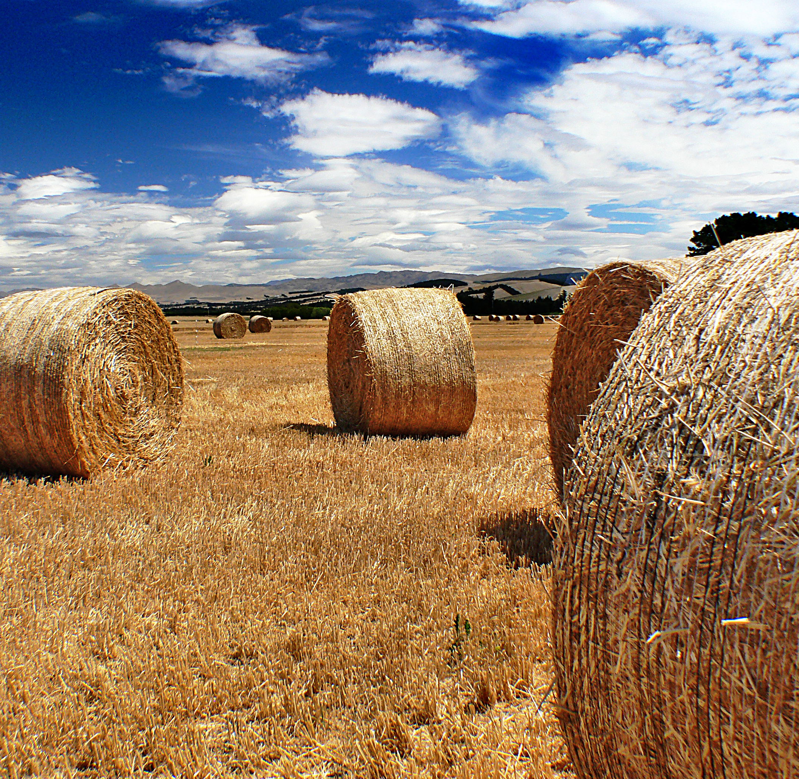
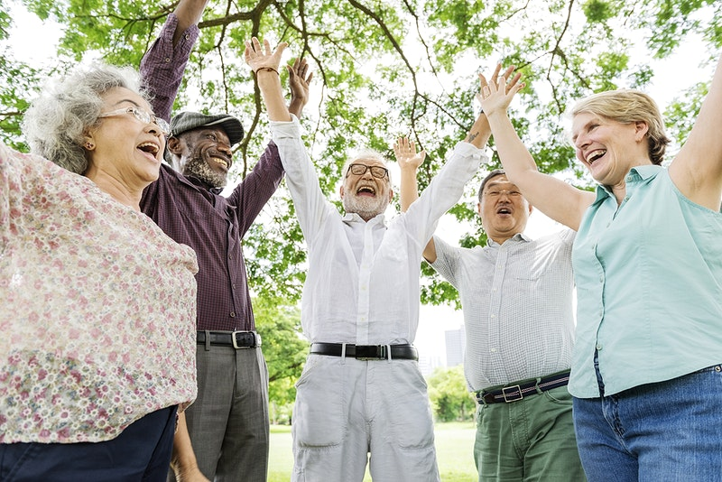
The Harvest Field is made up on individual life stories

Slide 15
The importance of ministry to and with older people- The Harvest Field influenced by the ‘silver economy’
Helen McCormack
Pastoral & Development Worker
for Older People
Thirsk & Northallerton Methodist Circuit &
Zion URC Northallerton
Mobile: 07751 078506
Email: helenmethodisturc@outlook.com

