Slide 1

‘Understanding Mental Health Problems’ – When is mental health spiritual health in older people?
Prof Austyn Snowden
13th April 2021
Invited presentation to: Faith in Older People

Slide 2
Overview
Overlap between mental and spiritual health.
Formal classification of depression and the anxiety disorders
Classification of Spiritual Disorders?
Meeting spiritual need in Primary Care:
  Measurement?
  Persuasion?
An example of a study designed to help people in spiritual distress in primary care
Scottish Patient Reported Outcome Measure (PROM),
Notes:
This webinar will look at overlap between mental and spiritual health. It will examine the formal classification of depression, dementia, and the anxiety disorders to show that these are all constructs built from a range of signs and symptoms and their severity. It will then introduce the Scottish Patient Reported Outcome Measure (PROM), a validated measure of the impact of chaplain interventions for people in spiritual distress. The Scottish PROM is a scale measure, made up from patient responses to five items related to spirituality. In the webinar, Professor Snowden considers the overlap between these five items and the signs and symptoms of depression and anxiety inparticular and considers the consequences of confounding mental and spiritual health in older people.

Slide 3
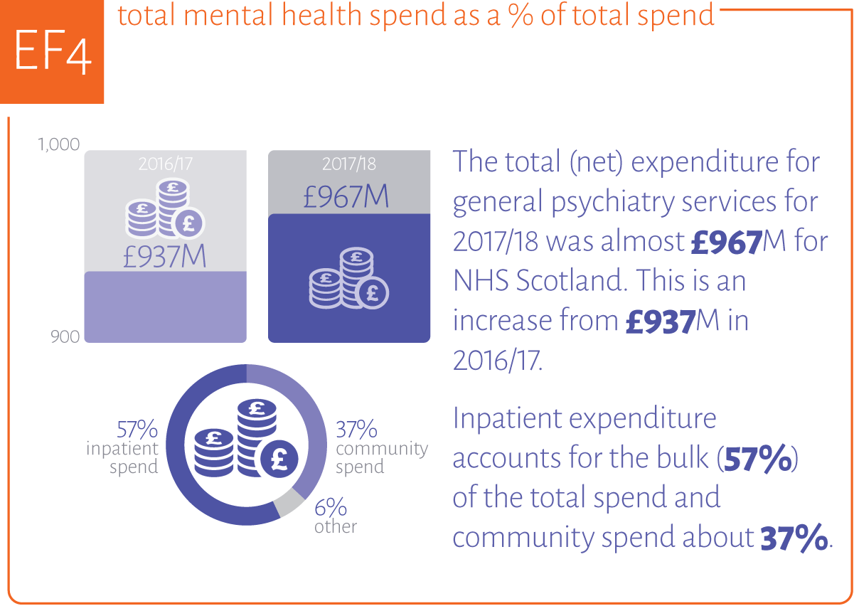
Mental Health
https://www.isdscotland.org/Health-Topics/Quality-Indicators/Mental-Health-Quality-Indicator-Profile/Publications/2019-09-17/Progress/

Slide 4
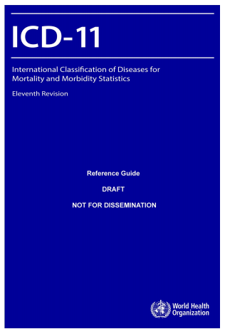
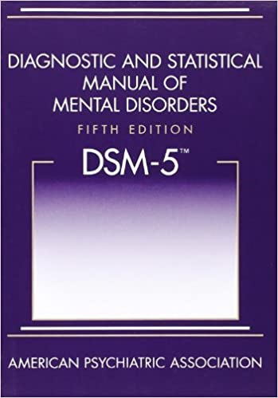
Mental Ill Health

Slide 5
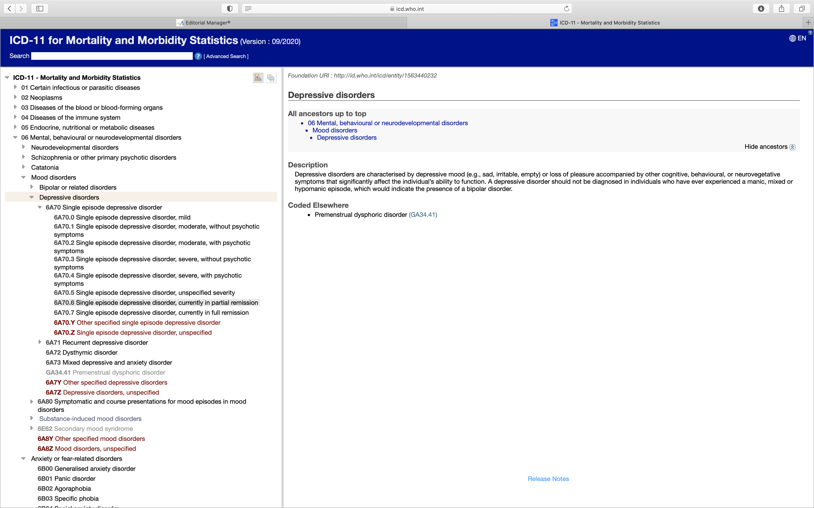
ICD example

Slide 6
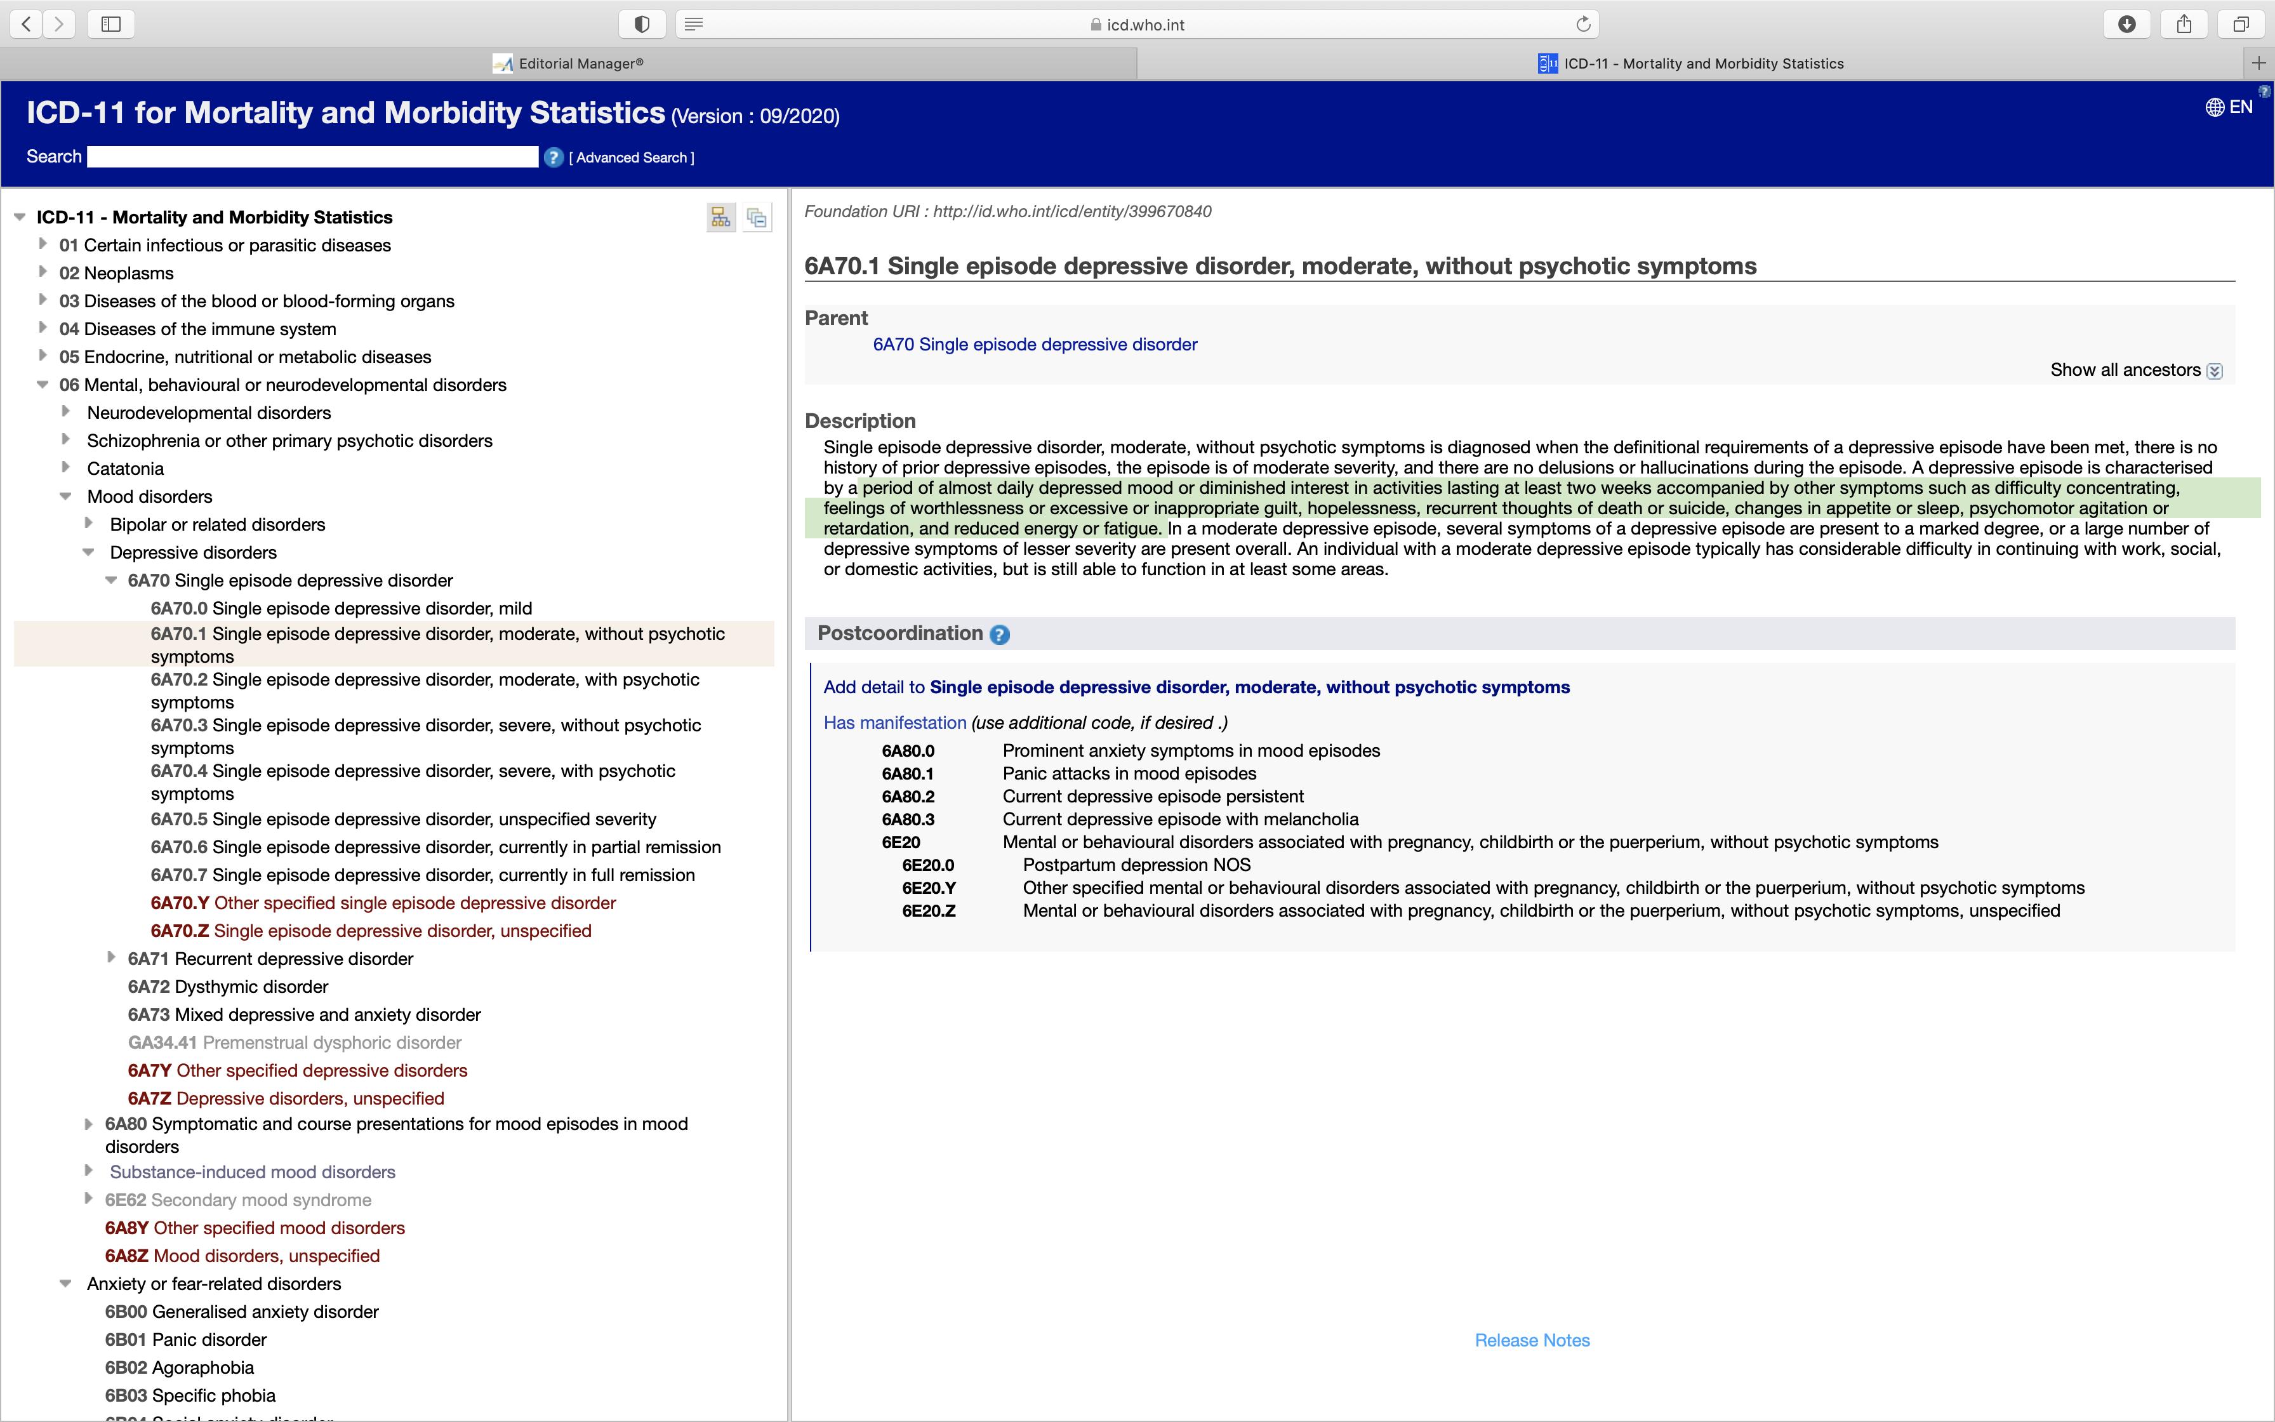

Slide 7
6A70.1 Single episode depressive disorder, moderate, without psychotic symptoms
…period of almost daily depressed mood or diminished interest in activities lasting at least two weeks accompanied by other symptoms such as difficulty concentrating, feelings of worthlessness or excessive or inappropriate guilt, hopelessness, recurrent thoughts of death or suicide, changes in appetite or sleep, psychomotor agitation or retardation, and reduced energy or fatigue.

Slide 8
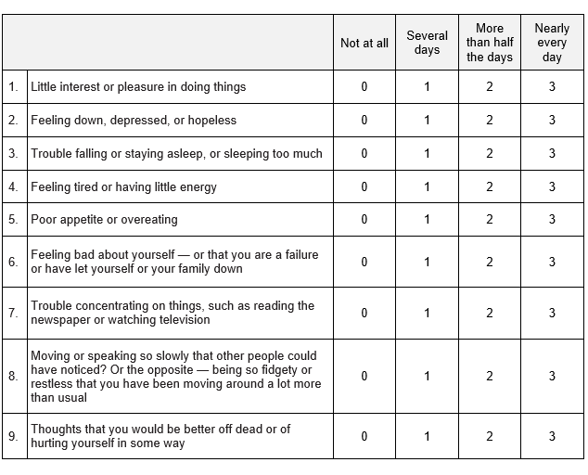
PHQ-9
In the last two weeks…

Slide 9
Depression
DEAD SWAMP
Depressed mood most of the day
Energy loss or fatigue
Anhedonia
Death thoughts (recurrent), suicidal ideation or attempts
Sleep disturbances (insomnia, hypersomnia)
Worthlessness or excessive guilt
Appetite or weight change
Mentation decreased (ability to think or concentrate, indecisiveness)
Psychomotor agitation or retardation

Slide 10
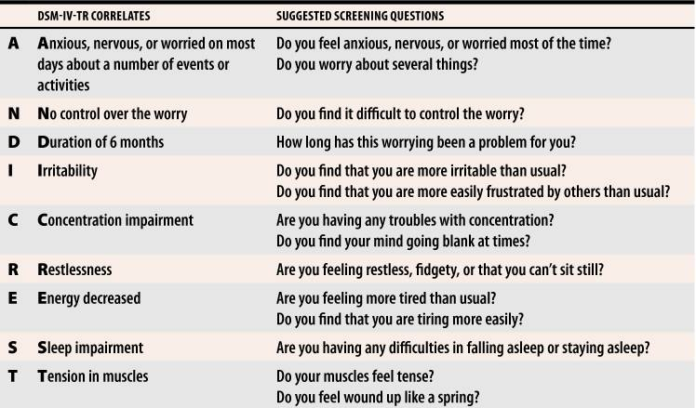
Mnemonics

Slide 11
Change over time?
Frequency of “idiocy/insanity” in the 1840 census. 1880 census:
Mania, melancholia, monomania, paresis, dementia, dipsomania, and epilepsy.
ICD-6 included MI for 1st time= DSM 1 1952
Homosexuality not in 7th edition of DSM 2 1974.
265 diagnoses in DSM 3
365 in DSM IV
197 in DSM V, but volume huge

Slide 12
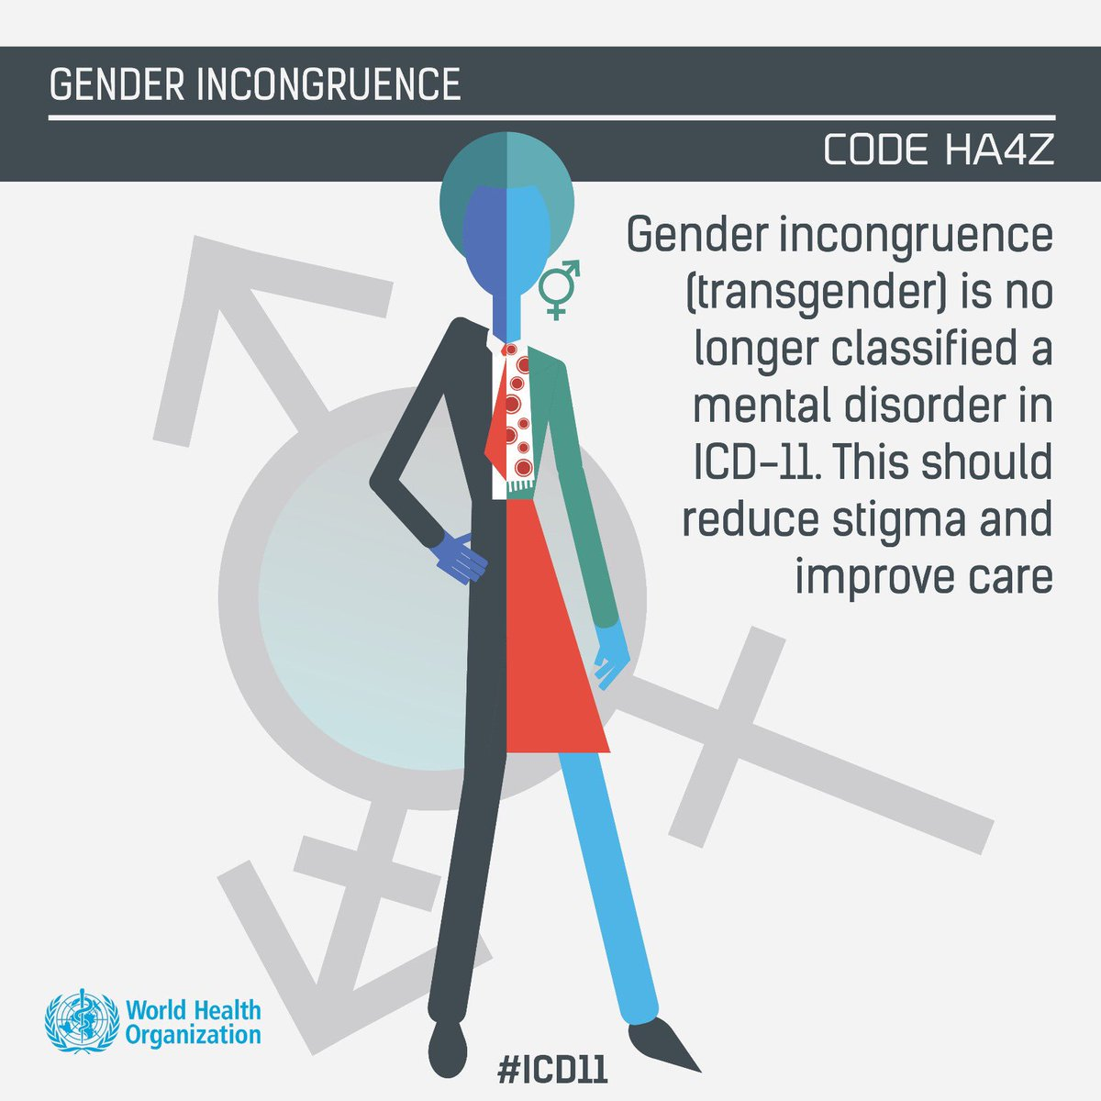
DSM 5 & ICD-11
Asperger's Syndrome was eliminated as a diagnosis and, instead, incorporated under the category of autism spectrum disorder.
Disruptive mood dysregulation disorder was added, in part to decrease over-diagnosis of childhood bipolar disorders.
Several diagnoses were officially added to the manual, including binge eating disorder, hoarding disorder, and premenstrual dysphoric disorder.

Slide 13
Difference between unhappiness & disorder
Time.
Distress.

Slide 14
Spiritual distress?
﻿“Spiritual care … recognises and responds to the needs of the human spirit when faced with trauma, ill health, or sadness.“
Notes:
In conclusion, the present study confirmed four types of connection in the definition of spiritual health: human connection with God, himself, others and the nature. Most of the experts who participated in the current study recognized human connection with God as the most important part of the definition of spiritual health and also stated that human connection with God is the most important component and indicator of spiritual health. Other studies, on the other hand, could not show the superiority of one component over the others. Human connection with himself, others and the nature is not specific to spiritual health because these components of spiritual health are present in mental and social health as well. Although we found different definitions for spiritual health, we believe that these may differ based on individuals’ beliefs and opinions. It is suggested that further longitudinal studies be conducted to provide more accurate explanations for spiritual health by interdisciplinary collaboration between mental health specialists, social health specialists and religious scholars. Such studies would result in more accurate research on spiritual health and its causal relationship with physical health, mental health and social health.

Slide 15
Spiritual distress
…is when a person is no longer able to find meaning, peace, comfort, strength, or connection in life.
  Feelings of anger or hopelessness
  Feelings of depression and anxiety
  Difficulty sleeping
  Feeling abandoned by God
  Questioning the meaning of life or suffering
  Questioning beliefs or sudden doubt in spiritual or religious beliefs
  Asking why this situation occurred
  Seeking spiritual help or guidance

Slide 16
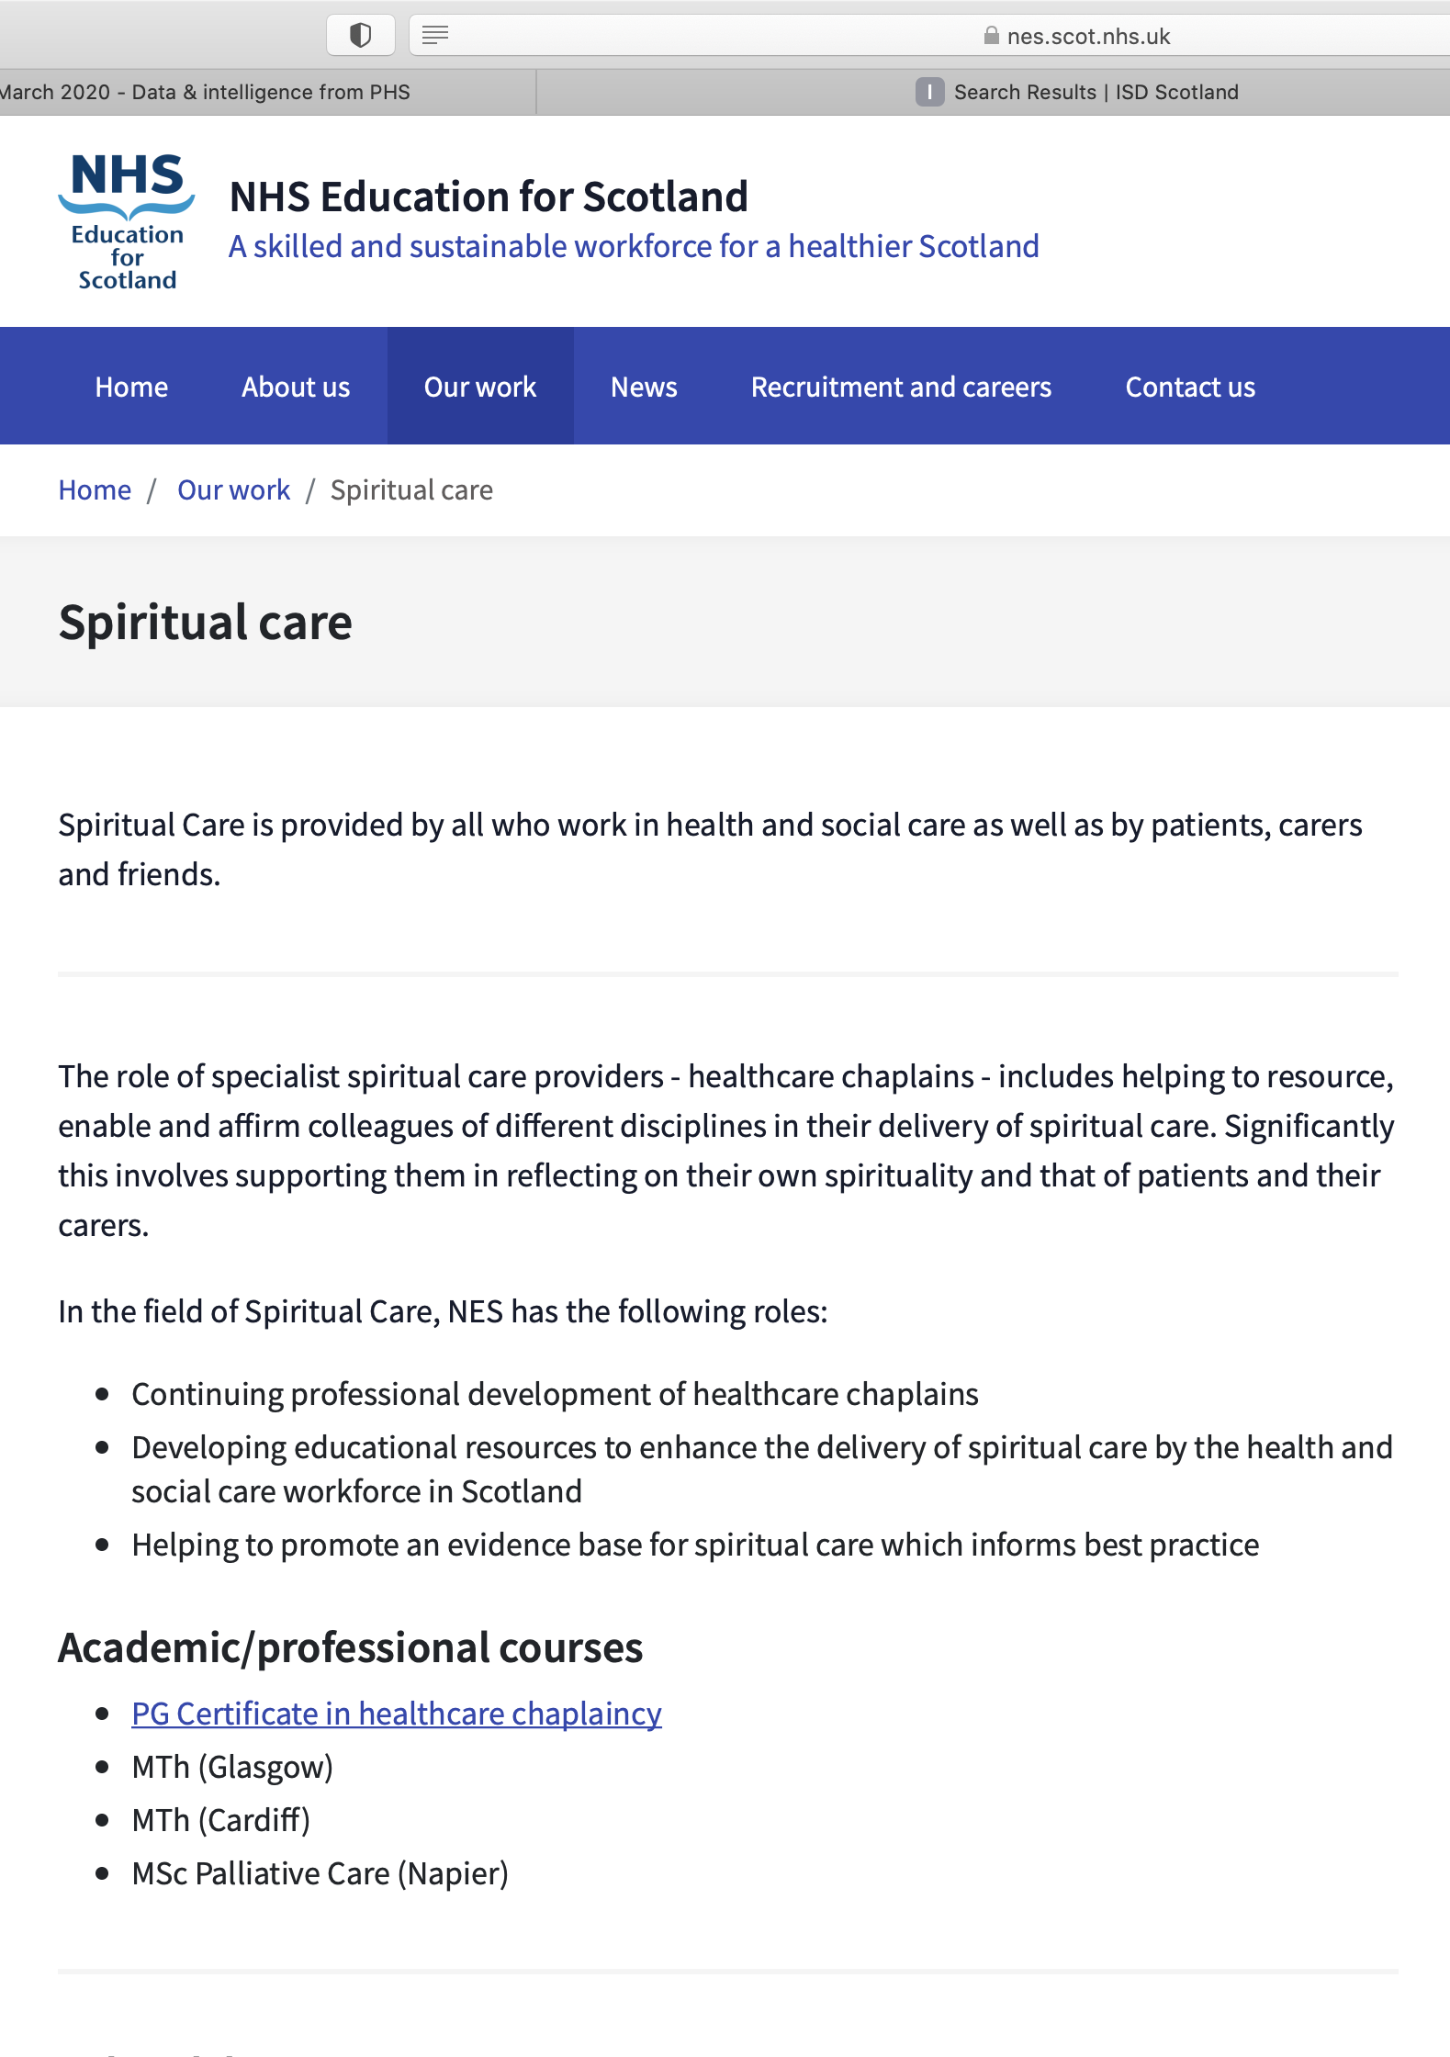
Spiritual Care

Slide 17
Understanding the importance of spiritual care
﻿Spiritual care is not religious (although religious care that is given in the context of the shared religious beliefs, values, liturgies, and lifestyle of a faith community may be spiritual) and it is an important aspect of holistic patient care. There are two challenges:
  first, developing instruments that will more accurately assess the effectiveness of spiritual interventions and,
  second, persuading GPs and other healthcare professionals of the importance of providing good spiritual care.

Slide 20
Thoughts
Perhaps if we could identify people in spiritual distress we could help them?
Spiritual distress is something everyone may suffer, not just the religious?
Perhaps in future the GP will be regarded as the generalist in spiritual care who refers appropriate patients to the chaplain, who is the specialist in spiritual issues.
‘PHQ-9’ for spiritual care??

Slide 21
Context
All NHS employees are required to provide economically sound, evidence-based care.
In Scotland this is articulated in The Healthcare Quality Strategy for Scotland (The Scottish Government, 2010).

Slide 22

The Original NES Project Goal (2010)
Develop a tool for use in a Scottish context to show the impact of health care chaplaincy on patient well-being.

Slide 23

A series of structured questions that ask patients about their health from their point of view
usually in the light of
specific treatment or intervention

Slide 24
…only a chaplain will hear you as you are.

Slide 25

Things the chaplain does
During your visit with the chaplain: | None of the time | Rarely | Some of the time | Often | All of the time
I was listened to
My faith/beliefs were valued
I was able to talk about what was on my mind
My situation was understood

Slide 26
After being with the chaplain
Over the last two weeks I have felt: | None of the time | Rarely | Some of the time | Often | All of the time
I could be honest with myself about how I was really feeling
anxious
I had a positive outlook on my situation
in control of my life
a sense of peace

Slide 27
Free text comments
Thank you for listening to what was on my mind
Thank you very much for completing this questionnaire.
Please return in envelope to A.N Other, address.
© NHS Education for Scotland 2020. You can copy or reproduce the information in this document for use within NHSScotland and for non-commercial educational purposes. Use of this document for commercial purposes is permitted only with the written permission of NES.

Slide 28
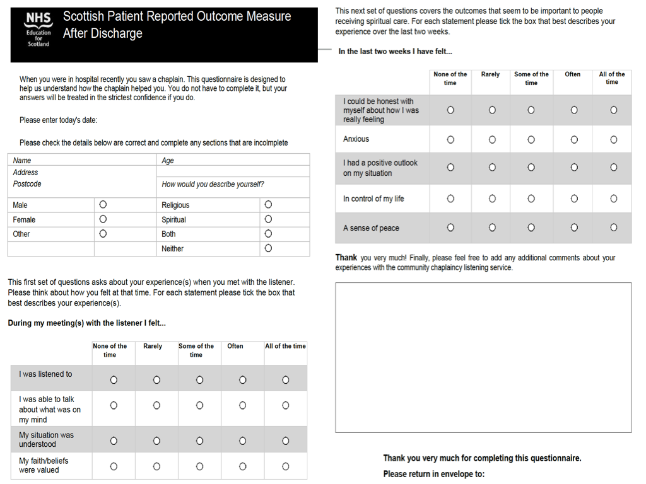
Things the chaplain impacts upon
0
1
2
3
4
Things the person is
These five questions are the ‘PROM’
Things the chaplain does

Slide 29
0
1
2
3
4
0
1
2
3
4
0
1
2
3
4
0
1
2
3
4
0
1
2
3
4

Slide 30
0
1
2
3
4
0
1
2
3
4
0
1
2
3
4
0
1
2
3
4
0
1
2
3
4
3 + 3 + 3 + 3 + 2 = 14/20

Slide 31



Scores from 1117 PROMS
25%
45%
30%

Slide 32
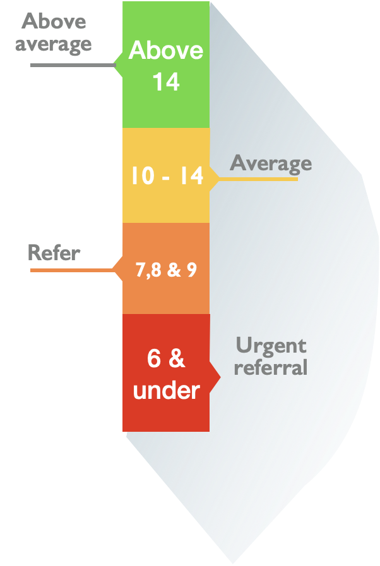

PROM scores identify spiritual distress?

Slide 33
A study: Community Chaplaincy Listening
Post intervention PROM
Finish
Person discharges self from CCL
Person completes follow up
Person continues to meet chaplain for as long as they need to
Person meets with chaplain. Chaplain listens
Baseline PROM
Start
Person attends GP surgery. GP recommends CCL

Slide 34
Results (n = 101)
Post Intervention
Average PROM score = 12
Average PROM score = 8
Baseline

Slide 35
AND?
People who saw chaplain
Did not return to GP as much
Were seen quicker, cheaper and possibly better?
Didn’t need meds
Didn’t get labelled
Got heard
People who didn’t see chaplain
‘Treatment as usual’
???

Slide 37
RCT
Experimental
‘modern maladies’/LOADS SHARED
Complete baseline measures (PROM, WEMWBS)
See chaplain
Complete f/up measures 6, 12, 52 weeks
Control
‘modern maladies’/LOADS SHARED
Complete baseline measures (PROM, WEMWBS)
TAU
Complete f/up measures 6, 12, 52 weeks

Slide 38
Recall…
Overlap between mental and spiritual health.
Formal classification of depression and the anxiety disorders
Classification of Spiritual Disorders?
Meeting spiritual need in Primary Care:
  Measurement?
  Persuasion?
An example of a study designed to help people in spiritual distress in primary care
Scottish Patient Reported Outcome Measure (PROM),
Notes:
This webinar will look at overlap between mental and spiritual health. It will examine the formal classification of depression, dementia, and the anxiety disorders to show that these are all constructs built from a range of signs and symptoms and their severity. It will then introduce the Scottish Patient Reported Outcome Measure (PROM), a validated measure of the impact of chaplain interventions for people in spiritual distress. The Scottish PROM is a scale measure, made up from patient responses to five items related to spirituality. In the webinar, Professor Snowden considers the overlap between these five items and the signs and symptoms of depression and anxiety inparticular and considers the consequences of confounding mental and spiritual health in older people.

Slide 39
RCT outcome
Measurement
Empirical evidence for the impact of chaplains…
Persuasion
…should be helpful in persuading other GPs to try it.

Slide 40
Thank you
Contact
Prof Austyn Snowden
A.Snowden@napier.ac.uk
References
Macdonald, G. (2019). Spiritual needs assessment: the LOADS SHARED mnemonic. British Journal of General Practice, 69(688), 573–574. https://doi.org/10.3399/bjgp19x706505
Snowden, A., Gibbon, A., & Grant, R. (2018). What is the impact of Chaplaincy in Primary Care? The GP perspective. Health and Social Care Chaplaincy, 6(2), 200–214. https://doi.org/https://doi.org/10.1558/hscc.34709 HSCC
Snowden, A., & Telfer, I. J. M. (2017). A Patient Reported Outcome Measure of Spiritual care as delivered by Chaplains. Journal of Health Care Chaplaincy, 23(4), 1–25. https://doi.org/10.1080/08854726.2017.1279935

